Slide 1
Integrated management of acute malnutrition
Republic of Kenya
Ministry of Health
Emergency Nutrition Response

Slide 2
ACKNOWLEDGMENT
MINISTRY OF PUBLIC HEALTH
MINISTRY OF MEDICAL SERVICES

Slide 3
Overall Objective
To prepare health workers for prompt and effective response to Nutrition Emergencies

Slide 4
Learning Objectives
By the end of this session, participants should be able to:
Understand what causes nutrition emergencies
Identify which groups are most nutritionally vulnerable in an emergency
Be aware of the different types of emergencies
Identify steps in Emergency Response
Be aware of the range of food related emergency nutrition responses and when they are appropriate
Identify requirements for emergency Nutrition Intervention
Understand the coordination mechanism in emergency response

Slide 5
Contents
Overview
Nutrition Emergency Response preparedness and response actions
Actions for Nutrition Emergency Response
Implementing Emergency Response Nutrition Interventions
Supply Chain and logistics in Emergencies
Monitoring
Linking Nutrition Programmes and Other Interventions

Slide 6
Emergency and Humanitarian Situation
Emergency: an extreme disruption that causes widespread human, material or environmental losses that exceed the ability of the affected society to cope using only its own resources
Humanitarian Situation: circumstance where humanitarian needs are sufficiently large and complex to require significant external assistance and resource requiring multi-sectoral response
Kenya Emergency is characterized by hazards that are Rapid Onset and Slow onset
Food and nutrition emergencies arises due to depleted food supplies leading to acute malnutrition
Emergency food and nutrition interventions protect access of affected populations to adequate nutrition
OVERVIEW

Slide 7
Vulnerable Groups In Emergencies
The population groups most nutritionally vulnerable in emergencies can be categorised as follows;
Physiological vulnerability :
young children,
pregnant and lactating women,
older people,
the disabled and
people living with chronic illness such as HIV and AIDS)
OVERVIEW

Slide 8
Vulnerable Groups In Emergencies
The population groups most nutritionally vulnerable in emergencies can be categorised as follows:
Geographical vulnerability (e.g. people living in drought or flood-prone areas or in areas of conflict)
Political vulnerability (e.g. oppressed populations)
Internal displacement and refugee status (e.g. those who have fled with few resources)
OVERVIEW

Slide 9
Situation of Kenya
Humanitarian health and nutrition actors include:
National Government frameworks for resilience programming institutionalised (Ending Drought Emergencies 2013-2017)
UN agencies (WHO, WFP, UNICEF, UNHCR, OCHA) which work with the Red Cross, NGOs, CBOs, religious groups and co-operations. (See handout 6a )
OVERVIEW

Slide 10
Causes of Nutrition Emergencies
Rapid onset: floods in , conflict displacement due to insecurity, inter-communal violence and terrorist attacks, post-election violence, disease epidemics (cholera, polio, measles)
Slow onset: drought, flood, refugee influx that are seasonal/cyclical/chronic (e.g. combination of cyclic drought-induced crop failure, 2011 drought in Kenya and the Horn of Africa , refugee influx in Daadab and Kakuma)
OVERVIEW

Slide 11
Nutrition Emergency Preparedness and Response Actions
Preparedness
Mobilizing Resourses

Slide 12
PREPAREDNESS
Aims to build capacities needed to efficiently manage all types of emergencies
Contingency planning identifies and plans for emergency situations and is prepared annually at national and county level
Contingency Plan elaborates the preparedness and response actions for coordinated response to crisis and implemented only in the event of an emergency.
Continuously reviewed
EMERGENCY PREPAREDNESS

Slide 13
MOBILIZING RESOURCES
Understanding of Humanitarian and National Government appeals and funding mechanisms
b) Prioritization focused on most urgent needs, and be transparency
c)Response plans that address all types of resource mobilization – finance, people, supplies
EMERGENCY PREPAREDNESS

Slide 14
Actions for nutrition emergency response
7 ACTIONS

Slide 15
ACTION 1: COORDINATION
Key focal points for coordinating response include:
Ministry of Interior and Coordination of National Government focuses on Disaster and Emergency Coordination (NDOC),
National Drought Management Authority
Crisis Reponse Center
Kenya National Nutrition Action Plan (2012- 2017) defines nutrition objectives to be addressed
Nutrition Technical Forum (NTF) is responsible for technical coordinating structure and technical capacity
ACTION FOR RESPONSE

Slide 16
ACTION 2: Assessments and Monitoring
Gain an understanding of impact of emergency through the following information sources:
Nutrition surveillance (slow-onset/chronic emergencies)
Rapid nutrition assessments (rapid-onset emergencies)
Anthropometric nutrition surveys (slow-onset/chronic emergencies OR rapid-onset emergencies)
ACTION FOR RESPONSE

Slide 17
Nutrition Surveillance
Process of monitoring trends in the nutrition situation over time is of high importance
Enables management of risks associated with impending crisis and reduces impact of shock
Kenya Surveillance system include:
Revised Early Warning System for Kenya
Seasonal Assessments:
Health facility monitoring from the DHIS
ACTION FOR RESPONSE

Slide 18
Nutrition Surveillance
Objectives include:
Advocacy
Identification of appropriate response strategies
Triggering a response
Targeting
Identification of malnourished children
ACTION FOR RESPONSE

Slide 19
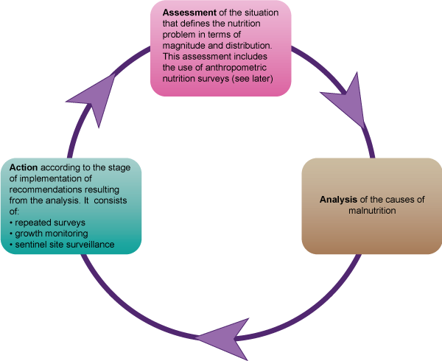
Nutrition Surveillance Cycle
ACTION FOR RESPONSE

Slide 20
Rapid Nutrition Assessments
To obtain a snapshot of the nutrition situation as quickly as possible
Performed in situations of poor security and limited access
Information not statistically valid but verify existence or threat of nutrition emergency
Enables estimation of affected population and immediate needs
ACTION FOR RESPONSE

Slide 21
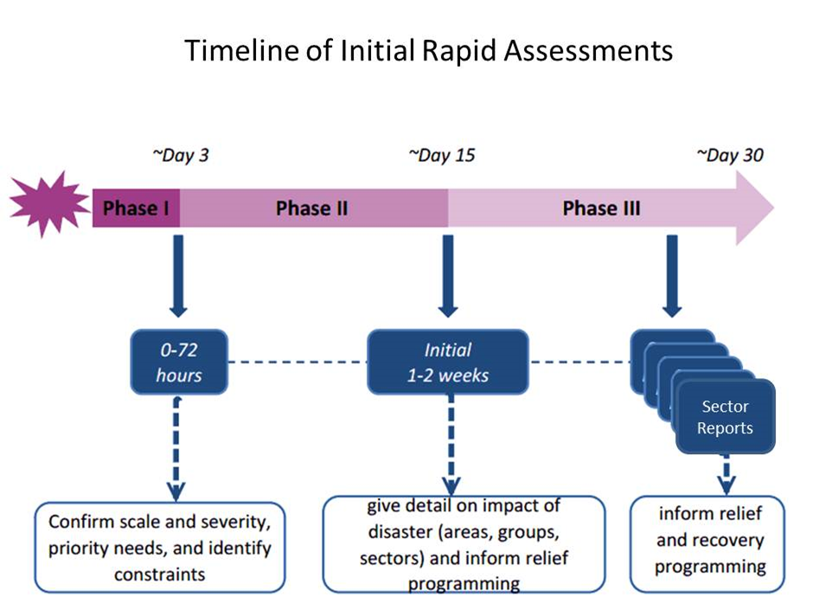
ACTION FOR RESPONSE

Slide 22
Rapid household level nutrition assessment
Conducted based on KIRA findings and within 6 weeks
Provides required information not covered by KIRA assessment
Objective is gather data quickly and give estimate of nutrition situation
The exercise should not exceed four days
ACTION FOR RESPONSE

Slide 23
Rapid household level nutrition assessment - Objectives
To estimate the nutritional status of children aged 6-59 months and PLW using MUAC
To establish factors contributing to the overall nutrition situation of the affected population
To be informed on the infant and young child feeding practices in the affected population
To make recommendations that prevents deterioration of the nutrition situation
ACTION FOR RESPONSE

Slide 24
Rapid household level nutrition assessment- Methodology
Purposive selection of locations based on identified need for additional information
Quantitative data through MUAC measurement
Qualitative date through Focus Group discussions, Key informant Interviews , Secondary data and anthropometric surveys
ACTION FOR RESPONSE

Slide 25
Action 3: Promote, Protect and Support Maternal Infant and Young Child Nutrition in Emergencies (MIYCN-E)
To reduce high risk of under nutrition during emergencies for optimal growth and development of children
Includes protecting rights of all pregnant women, lactating mothers , infants and young children
ACTION FOR RESPONSE

Slide 26
Action 3: (MIYCN-E) – POLICY GUIDELINES
Ensure that mothers and their infant are not separated for continuation of optimal infant feeding
Protect, promote and support exclusive breastfeeding and optimal complementary feeding (assess need for supplementary food rations) in all emergency efforts.
Periodic nutrition monitoring and surveillance including rapid assessments fostered and facilitated.
ACTION FOR RESPONSE

Slide 27
Action 3: (MIYCN-E) – POLICY GUIDELINES
Technical representation in humanitarian coordination forums and promotion of cross-sector engagement.
Policy, guidelines and standards for IYCN-E meet Inter-Agency Standing Committee (IASC) and SPHERE standards, and that systems support adherence.
Minimize the risk of artificial feeding through ensuring that all emergency efforts including donations comply with BMS regulation and control Act 2012.
ACTION FOR RESPONSE

Slide 28
Action 3: (MIYCN-E) – POLICY GUIDELINES
Optimal IYCN practices according to MIYCN policy
Monitor the following indicators:
Timely initiation of breastfeeding
Minimum dietary diversity
Minimum meal frequency
Violation of the BMS act
Emergency preparedness (Adequate local capacity, advocacy and national legislation in place)
ACTION FOR RESPONSE

Slide 29
Action 3: (MIYCN-E) – POLICY GUIDELINES
Protect, promote, and support optimal maternal infant and young child nutrition through:
Caregiver and children have timely access to skilled feeding support
Provide information to families on MIYCN
Support to breastfeeding mothers
Access to safe and adequate complementary feeding
Advocacy to meet and protect nutritional needs of population and children
Appropriate feeding for children with no prospect to be breasfed
ACTION FOR RESPONSE

Slide 30
Action 4: Mount Capacity at Facility and Community level
Availability of policies and guidelines for HiNi interventions
Regular orientation and sensitization on policies and guidelines through retraining and mentoring of health workforce
Kenya Red Cross Society is country’s first line responder and deploys team of volunteers and emergency health personnel
ACTION FOR RESPONSE

Slide 31
Action 5: Provide appropriate nutritional products, and equipment for management of acute malnutrition
Stock piling and pre-positioning of supplies and equipment
Availability of complete basic kits at Humanitarian hubs and awareness of where to get nutritional products
Forecasting and nutrition supplies chain management
ACTION FOR RESPONSE

Slide 32
Action 6:Continuous Service Delivery of High Impact Nutrition Interventions
Partners work through government leadership
Remote management when access is not possible
ACTION FOR RESPONSE

Slide 33
Action 7: Streamlined Communications & Advocacy
Use of available validated package of relevant nutrition messages for advocacy
ACTION FOR RESPONSE

Slide 34
Implementing Emergency Nutrition Responses

Slide 35
Scaling Up nutrition emergncy response
Preparedness by promoting readiness and the ability to cope and respond to emergencies at all levels.
Prevention of emergency situations to the extent possible.
Mitigation: minimize the effects of the emergency.
Inter sectoral collaboration : meet the needs of people affected by the emergency situation in a coordinated, efficient and timely manner.
EMERGENCY RESPONSE

Slide 36
General Feeding Programme(gfd)
Food rations given to selected highly affected households delivered as a package of dry items
Objective is to save lives, protect nutritional status of population and rehabilitate livelihoods
GFD used to respond to food need based on livelihood, economic, nutritional and key vulnerable group targetting
Rations must provide at least 2100 kcal per person per day.
EMERGENCY RESPONSE

Slide 37
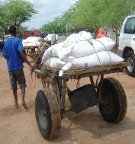
General Feeding Programme
Provides food to the affected population as a whole.
General rations are usually provided as dry rations for people to cook in their homes.
The local community's food habits, tastes and preferences must be taken into consideration when distributing general food rations.
INTERVENTIONS

Slide 38
Blanket Supplementary feeding (BSFP)
Provide a food supplement to all members of an at-risk group (e.g. children, pregnant and lactating women) irrespective of nutritional status.
Objective to prevent nutritional deterioration, related mortality and morbidity
Implemented when :
GAM is > 20% with aggravating factors
Inaccessibility of target population
Early stage of an acute crisis
EMERGENCY RESPONSE

Slide 39
BSFP- Target Group and Entry
Children under 5 years: Height < 110 cm
Pregnant and Lactating women with children < 6 months
EMERGENCY RESPONSE

Slide 40
BSFP- food rations and treatment
Food rations: Timely Distribution, prepositioning of stocks
Treatment: Vitamin A, deworming tablets, zinc, iron/folate tablets, micronutrient powders and immunizations
Beneficiary Identification: registered and provided with serialized ration cards for ease in follow up, and to avoid double distributions
Phased out when:
there is anticipated decrease in acute malnutrition rates
Target groups no longer vulnerable
GFD is adequate
EMERGENCY RESPONSE

Slide 41
BSFP Programme set up
Human Resource requirements on site: Nurse, CHWs, Clerks, Guards, VHCs
Sub county/county level: Team Leaders, an M&E officer, Logistician and Programme Coordinator.
BSFP staff to beneficiaries ratio per site: 1000 beneficiaries per site OR 250 beneficiaries per team
Supplies: Office spacce, equipment, materials
BSFP Documentation: All data collected during BSFP feeds into the DHIS, and existing MOH tools should be used should be BSFP reporting
EMERGENCY RESPONSE

Slide 42
BSFP Programme set up
Supervision and Management
Supervision is important to ensure effective implementation of response programs
Managers are accountable for their decisions and for ensuring adequate security and compliance to the codes of conduct
All staff must have a written job description with clear reporting lines and undergo periodic performance assessments
Transport must be provided for supervisory personnel on a full time basis
EMERGENCY RESPONSE

Slide 43
BSFP Programme set up
Linkages with IMAM: Acute Malnutrition cases referred to IMAM programmes for treatment and follow up
Supplementary Feeding : Can be take home (Dry rations) weekly or very two weeks OR onsite feeding (wet ration) everyday at a feeding center
EMERGENCY RESPONSE

Slide 44
Methods of Supplementary Food Distribution
Take-home / dry ration | On-site feeding / wet ration
A regular (weekly or bi-weekly) distribution of food in dry form to be prepared at home. Generally, take-home or dry ration is the preferred option as it requires fewer resources and less hardship on the patients. There is no evidence that on-site SFPs are more effective. | A daily distribution of cooked food at feeding center offered. Only considered for extreme situations as it is time consuming and also undermines the family's ability to take responsibility It also may also create undesired population movements into centres The number of meals provided varies, but, usually 2 - 3 meals each day.
EMERGENCY RESPONSE

Slide 45
BSFP Programme set up
Advantages Dry feeding
Advantages Wet Feeding
It is easier to organize when resources are limited
Serves more children with lower risk of transmission of communicable diseases
Better coverage
Takes up less of mother’s time
Easily accessible for a dispersed population
Prevents displacement
cooking facilities (fuel, pots) are a major problem in the community
Feeding population influx/displacement at reception/transit centers
Food supply in the household is extremely limited prevents sharing of supplementary rations
Good for orphans and/or unaccompanied children
EMERGENCY RESPONSE

Slide 46
SUPPLY CHAIN LOGISTICS IN EMERGENCIES

Slide 47
Procurement
Ensures organizations involved in relief management have resources needed to meet identified needs
Requires identifying the sources of those goods and services and the way in which they will be acquired
SUPPLY & LOGISTICS

Slide 48
Transport
A transport strategy must consider:
The means of transport
Actual possibilities of getting supplies from point A to B
alternatives for the prompt, safe delivery of relief assistance
Seasonal delivery problems such as floods and impassable roads, will adversely influence the transportation.
SUPPLY & LOGISTICS

Slide 49
Storage
Purpose of storage is to protect the emergency supplies in an organized, systematic way until delivered to their ultimate recipients
It must also take into account reserve supplies, or stockpiles, for future or unforeseen needs.
Short-term food aid transit storage dictates the following major requirements:
security from theft
protection of stocks from enviromental factors like rain, and pests, especially rodents and birds
easy intake and dispatch of goods, including good access to the store
SUPPLY & LOGISTICS

Slide 50
Storage
d. good in-store handling arrangements and access to all stocks for inspection, physical stock-taking and insect pest control where necessary
e. easy maintenance of the store structure
f. Satisfactory working conditions for staff and laborers.
g. Security is listed as the first requirement for consideration in storage because it is particularly important in transit stores, which are frequently opened, often located in towns, and commonly contains fast-moving foodstuffs.
SUPPLY & LOGISTICS

Slide 51
Distribution
The chief goal of the logistics chain in relief operations is delivering aid to the people affected
SUPPLY & LOGISTICS

Slide 52
MONITORING DURING EMERGENCIES

Slide 53
Monitoring & Evaluation
Monitoring systems should be able to answer the following key questions
Do we have the resources we need to respond? – money, people, supplies
Are we making progress against targets (e.g., what is the coverage on key results)?
What is the quality of the response on the ground?
Monitoring should help manage risks -- reputational risk, risks of implementation risks and financial management risks

Slide 54
Monitoring & Evaluation - indicators
Response Actions | Indicators
1. Strengthened and/or established nutrition sector coordination mechanism | Minutes of the co-ordination forums and follow up of agreed on action point , reports on co-ordination
2. Undertake a multi-sectoral rapid assessment, including key priority information for nutrition, | Rapid assessment report
3. Monitor unsolicited donations, distribution and use of breast milk substitutes or milk powder, and take corrective action. | Reports on code monitoring
4. Appropriate and Continuous service delivery of High impact nutrition interventions for children, for vulnerable groups, including pregnant and lactating women, according to identified needs. | Routine reports, surveillance reports
5. Established systems for community mobilization as well as for the identification and referral of HiNi | Surveillance reports, routine reports
6 Provision of nutrition supplies and equipment | Stock reports

Slide 55
Linking Emergency Nutrition Programme with Other Interventions

Slide 56
Linking Nutrition Programmes And Other Interventions
To ensure a smooth operation and correct priorities, the various implementing agencies must coordinate their work.
The most effective and efficient care first ensures that potable water and general food needs are met while rapidly establishing disease control measures
Providing shelter and essential non-food items (water containers, blankets and possible fuel sources for cooking) is the next priority.

Slide 57
Alternative Programs to Address Acute Malnutrition in Emergencies
Expanded GFD of a greater caloric content may have a similar effect to the BSFP ration
Cash/Vouchers may be an option where markets are functional and quality food is accessible to the population.
Expanded admission criteria in targeted SFP to a MUAC of 115 to 135 and /or WHZ -2 to -1.5 for a defined programmatic period would target those most likely of developing acute malnutrition.

Slide 58
questions

