Slide 1
Integrated management of acute malnutrition
Republic of Kenya
Ministry of Health
IN-PATIENT MANAGEMENT

Slide 2
ACKNOWLEDGMENT
MINISTRY OF PUBLIC HEALTH
MINISTRY OF MEDICAL SERVICES

Slide 3
Overall Objective
To equip learners with technical knowledge necessary to manage Severe Acute Malnutrition in an in-patient setting

Slide 4
Learning objectives
By the end of this session, participants should:
Be aware of basic principles of therapeutic care and its role in emergency interventions.
Understand the main protocols of the management of severe malnutrition and how they are implemented in inpatient care facilities.
Be able to identify the key points in planning and implementing a therapeutic care programme.
Be aware of the main dangers and complications during treatment of severe malnutrition, and the main principles of their management.
Be aware of special treatment for infants and treatment adaptations for HIV-infected patients.

Slide 5
Treatment Process
The management of severe acute malnutrition in the in-patient setting is divided into three phases:
  Stabilization Phase: nutrition and medical stabilization
  Transition Phase – Gradual increase in calorie intake
  Rehabilitation Phase- rapid weight gain phase (catch-up growth)

Slide 6
10 Essential Steps Approach
Treat/prevent Hypoglycaemia
Treat/prevent Hypothermia
Monitoring
Treat/prevent Dehydration
Correct Electrolyte imbalance
Treat Infection
Correct Micronutrient deficiency
Initiate cautious feeding
Achieve Catch-up growth
Sensory stimulation
Discharge preparation
Notes:
The treatment approach that has been outlined within the lectures is summarise in the 10 step approach.
Red bars are the areas that need considering in the acute or rescue phase of admission, grey bars become relevant as the recovery phase is entered.
Throughout monitoring is essential – although can be scaled down as the child improves.

Slide 7
Timeline of Activities for In-Patient Management of Severe Acute Malnutrition
Activities | Activities to be assessed and treated simultaneously during ETAT corresponding to the WHO specific protocols for SAM | Stabilization | Transition | Rehabilitation (Most children complete this phase in out-patient care with RUTF)
EMERGENCY TRIAGE ASSESSMENT AND TREATMENT (ETAT) | INITIAL TREATMENT FOR SAM CHILD | Day 1 up to 7-10 days | Week 2 | Weeks 2–12
Obstructed Breathing, central cyanosis/severe respiratory distress | 1. Treat hypoglycemia | -→ | Repeated as necessary | Repeated as necessary
2. Shock | 2. Treat hypothermia | -→ | Repeated as necessary | Repeated as necessary
3. Coma, convulsions | 3. Treat dehydration, including heart failure and restore electrolyte balance | -→ | Repeated as necessary | Repeated as necessary
4. Dehydration | 4. Treat Septic Shock | -→ | Repeated as necessary | Repeated as necessary

Slide 8
Activities | Activities to be assessed and treated simultaneously during ETAT corresponding to the WHO specific protocols for SAM | Stabilization | Transition | Rehabilitation (Most children complete this phase in out-patient care with RUTF)
5. Severe anemia | 5. Start to feed the child | -→ | Repeated as necessary | Repeated as necessary
6. Congestive heart failure | 6. Treat Infections | -→ | Repeated as necessary | Repeated as necessary
 | 7. Treat vitamin A deficiency , and manage other mineral and vitamin deficiencies | -→ | Repeated as necessary | Repeated as necessary
 | 8. Treat severe anemia | -→ | Repeated as necessary | Repeated as necessary
7. Blinding eye problems | 9. Treat Dermatosis | -------------------→ | Repeated as necessary | Repeated as necessary

Slide 9
FULL ASSESSMENT
History and examination |  | -----→ | Repeated as necessary
Laboratory and other investigations |  | -----→ | Repeated as necessary
Differential diagnoses |  | -----→ | Repeated as necessary
INPATIENT TREATMENT
Continued treatment
Prevention of hypoglycaemia |  | -------------------→ | -----------------→ |  | -------------------→
Prevention of hypothermia |  | -------------------→ | -----------------→ |  | -------------------→
Management of infections and other medical conditions |  | -------------------→ | -----------------→ |  | -------------------→
Management of fluids and electrolyte balance |  | -------------------→ | -----------------→ |  | -------------------→
Feeding
Initial re-feeding for stabilization |  | -------------------→
Feeding in transition |  |  | ----------------------→

Slide 10
Feeding for catch up growth in rehabilitation |  |  |  |  |  | -------------------→
Monitoring and daily care
Monitoring of improvement |  |  | -------------------→ | -----------------→ |  | -------------------→
Monitoring of complications |  |  | -------------------→ | -----------------→ |  | -------------------→
Monitoring of failure to respond |  |  | -------------------→ | -----------------→ |  | -------------------→
Emotional and sensorial stimulation |  |  | -------------------→ | -----------------→ |  | -------------------→
Psychosocial support of mother or carer |  |  | -------------------→ | -----------------→ |  | -------------------→
Health and nutrition counseling and education |  |  |  | -----------------→ |  | -------------------→
 | Preparation for transfer and discharge
Preparation for discharge from hospital and transfer to outpatient care to continue treatment |  |  |  |  | -----------------→
Preparation for discharge from hospital and treatment |  |  |  |  |  | -------------------→

Slide 11
FULL ASSESSMENT
History and examination |  | -----→ | Repeated as necessary
Laboratory and other investigations |  | -----→ | Repeated as necessary
Differential diagnoses |  | -----→ | Repeated as necessary
INPATIENT TREATMENT
Continued treatment
Prevention of hypoglycaemia |  | -------------------→ | -----------------→ |  | -------------------→
Prevention of hypothermia |  | -------------------→ | -----------------→ |  | -------------------→
Management of infections and other medical conditions |  | -------------------→ | -----------------→ |  | -------------------→
Management of fluids and electrolyte balance |  | -------------------→ | -----------------→ |  | -------------------→
Feeding
Initial re-feeding for stabilization |  | -------------------→
Feeding in transition |  |  | ----------------------→

Slide 12
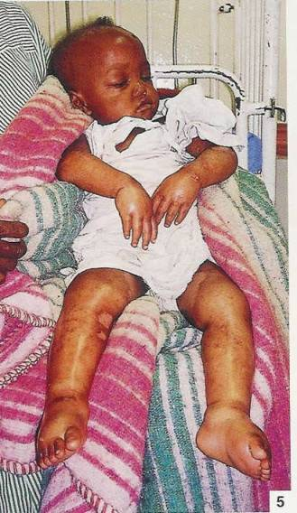
PHASE 1
Stabilization and rehabilitation
Nutrition Support
Routine Medication

Slide 13
Stabilisation and rehabilitation of malnourished patients
On admission (in-patient) check patient for and urgently address severe infections as well as hypoglycaemia, hypothermia, and dehydration.
Infections and electrolyte imbalance may manifest at any time during treatment and need to be monitored and treated
Correct micro-nutrient deficiencies

Slide 14
Steps for treatment in Phase 1
Steps 1-4: will be addressed in treatment of complications.
Step 5: Prevention and treatment of infections.
Step 6: Correct micro nutrient deficiencies.
Step 7: Cautious feeding.

Slide 15
ROUTINE MEDICATION
Severely malnourished patients do not exhibit classical signs of infection and therefore should be routinely treated for infection regardless of signs or symptoms.
Therefore on admission all beneficiaries are given broad-spectrum antibiotics and are immunized against measles (when appropriate)
If prophylaxis co-trimoxazole is being used (HIV), still add an additional systematic antibiotic
STEP 5: Treat and prevent infections
PHASE 1

Slide 16
Routine Medication: Antibiotics
First line antibiotic treatment if there are medical complications:
Penicillin (or Ampicillin, 50 mg/kg IV or IM every 6 hours for 2 days), followed by amoxicillin, 15 mg/kg orally every 8 hours for 5 days. (If amoxicillin is unavailable, give ampicillin, 50 mg/kg orally every 6 hours over a total of 7 days)
AND
Gentamicin, 7.5 mg/kg IM or IV daily single dose for 7 days

Slide 17
Routine Medication:Antibiotics
Second-line antibiotic treatment:
If the child fails to improve within 48 hours, add a second-line antibiotic
Ceftriaxone, 100 mg/kg (or 50 mg/kg if infant < 2 kg) IV or IM daily single dose for 5 – 10 days

Slide 18
Routine Medication: Antibiotics
Third line antibiotic treatment:
Systematic antifungal added for severe sepsis or systematic candidiasis
Nystatin/ Clotrimazole for oral thrush
Cloxacillin for suspected staphylococcus

Slide 19
ROUTINE MEDICATION: SYSTEMATIC ANTIBIOTICS
All SAM children receive antibiotic treatment upon admission, regardless of whether they present with clinical signs and symptoms of systemic infection or not.
Nearly all severely malnourished children have infections even if they are not symptomatic.
Children who have a poor appetite and require admission to Phase 1 should be treated blindly for infections.
Antibiotics are administered every day of Stabilisation phsae plus an additional 4 days or until transfer to community nutrition care.
Penicillin or ampicillin is identified as the first line antibiotic followed by amoxicillin (ampicillin if amoxicillin unavailabe)
STEP 5: Treat and prevent infections
PHASE 1

Slide 20
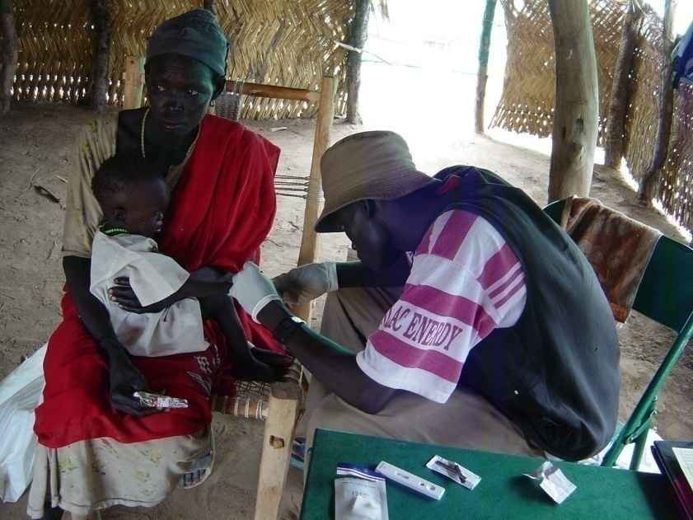
ROUTINE MEDICATION: MALARIA TREATMENT
Test all malnourished patients who are at risk of malaria before commencing treatment.
In malaria endemic areas all severely malnourished children are tested for malaria thereby use LLITNs.
Never give intravenous infusions of quinine to a severely malnourished patient in the first two weeks of treatment.
STEP 5: Treat and prevent infections
PHASE 1

Slide 21
ROUTINE MEDICATION: MEASLES PREVENTION
All SAM children 6 months and older when condition is stabilized
Second dose given before discharge
A further dose for those younger than 9 months after the age of 9 months
Full treatment of Vitamin A supplementation for children with recent history or current measles infection
Give at s months for HIV exposed children and during an outbreak
STEP 5: Treat and prevent infections
PHASE 1

Slide 22
ROUTINE MEDICATION – MICRONUTRIENT SUPPLEMENTATION
All severely malnourished children have vitamin and mineral deficiencies
The therapeutic products (F75, F100, RUTF) have sufficient vitamins /minerals to correct sub-clinical deficiencies
We do not recommend micronutrient syrup for this reason
STEP 6: Correct micronutrient deficiencies
PHASE 1

Slide 23
Routine medication: Vitamin A Supplementation
Sufficient Vitamin A in F75, F100, RUTF and locally developed milk with CMV
Do not give vitamin A routinely on admission or on discharge from in-patient therapeutic programme
Children with clinical signs of Vitamin A deficiency treated according to protocol
Give one dose to those with recent history of measles
Vaccinate all 6 months to 15 years incase of measles outbreak
STEP 6: Correct micronutrient deficiencies
STABILISATION PHASE

Slide 24
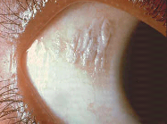
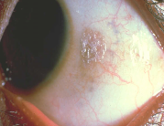
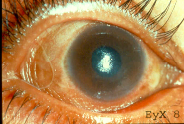
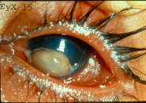
Vitamin A Deficiency -
Xeropthalmia
Administer vitamin A on day 1, 2 and 14
if patient has signs of severe deficiency;
Night blindness
Conjunctival Xerosis with Bitot's spots
corneal xerosis or
Keratomalacia)
STEP 6: Correct micronutrient deficiencies
Bitots spots
.
Corneal Xerosis
Keratomalacia
STABILISATION PHASE

Slide 25
Vitamin A systematic Treatment
Age | Vitamin A/IU orally on Day 1
6 to 12 months | 1 blue capsule (100,000IU = 30,000ug
12 months and older | 2 blue capsules (200,000IU = 60,000ug
STEP 6: Correct micronutrient deficiencies
STABILISATION PHASE

Slide 26
ROUTINE MEDICATION: FOLIC ACID SUPPLEMENTATION
Children receive 5mg of folic acid orally on day 1 and 1mg orally per day thereafter
Not to be given for children with SAM on RUTF
Moderate anemia treated according to protocol for medical complications
STEP 6: Correct micronutrient deficiencies
STABILISATION PHASE

Slide 27
Other Nutrients
F75, F100, RUTF and locally-developed milks with CMV contain the micro-nutrients required to treat the malnourished child.
Additional potassium, magnesium or zinc is NOT administered.
A “double dose” -one coming from the diet and the other prescribed - is potentially toxic.
STEP 6: Correct micronutrient deficiencies
STABILISATION PHASE

Slide 28
Summary Routine Medications
Medication | When
Antibiotic | At admission
Malaria Treatment | Test at admission and follow national protocols
Antihelmintics (Mebendazoleor Albendazole) | When the child progresses from transition to rehabilitation phase OR on arrival at out-patient therapeutic care
Measles Vaccine (for children 9 months and older) | One (1) vaccine at admission if no vaccination card One (1) vaccine after a month or on discharge from Rehabilitation Phase (if this is after a month)
Iron | During transition and rehabilitation phases WHEN THE CHILD IS NOT CONSUMING RUTF by adding to F100
Folic Acid | 5mg dose at admission and 1 mg dose daily afterwards
Children who have been transferred from out-patient care should not receive routine medications that have already been administered before.

Slide 29
Nutritional support: diet and frequencies
Feeding is cautious in the stabilization phase because of the child’s fragile physiological state and reduced homeostatic capacity.
Feeding at this stage is just sufficient in energy and protein to maintain basic physiological processes – meaning that the child should NOT gain weight
Feeds should be frequent and small: 130 ml/kg/day of F75 milk is the prescribed amount, usually broken into 8 feeds
Cautious feeding usually lasts 2-3 days
During the entire treatment, breastfeeding should be encouraged to continue
STEP 7: Cautious feeding
STABILISATION PHASE

Slide 30
Nutritional support: diet and frequencies
When the malnourished patient is in Phase 1, administer a milk diet only: either F75 or an equivalent locally-produced
milk product
The quantity of F75 given is dependent on body weight and age group (handout 2b)
The milk diet is given at regular intervals throughout the day (approximately every 2 - 3 hours)
To determine the amount per feed, divide the 24-hour required quantity by the number of feeds per day.
STEP 7: Cautious feeding
STABILISATION PHASE

Slide 31
A feeding plan
Admission
130 or 100 mls/kg/day as 3 hourly feeds, for 2 -7 days
STEP 7: Cautious feeding
F75
Notes:
31
The amount of starter formula depends on the clinical state:
130mls/kg/day for marasmus
100mls/kg/day if there is severe oedema.
This should be given as 2 hourly or 3 hourly feeds….including at night.
Once the appetite has recovered (often from 2-7 days after admission) a change to recovery or catch-up formula can be made.

Slide 32
APPROPRIATE FEEDING TECHNIQUE
The milk feed is given by cup. Any dribbles that fall into the saucer are returned to the cup
Never force feed the child
The mothers can sit together in a semi-circle around an assistant who observes and encourages the mothers.
Meal times are best to be social.
Caretakers should not take their meals beside the patient
STEP 7: Cautious feeding
STABILISATION PHASE

Slide 33
NUTRITIONAL SUPPORT : SITTING POSITION
  The child sits straight up (vertical) on the mother’s lap, leaning against her chest with one arm behind her back.
  The mother’s arm encircles the child. She holds a saucer under the child’s chin.
STEP 7: Cautious feeding
PHASE 1

Slide 34
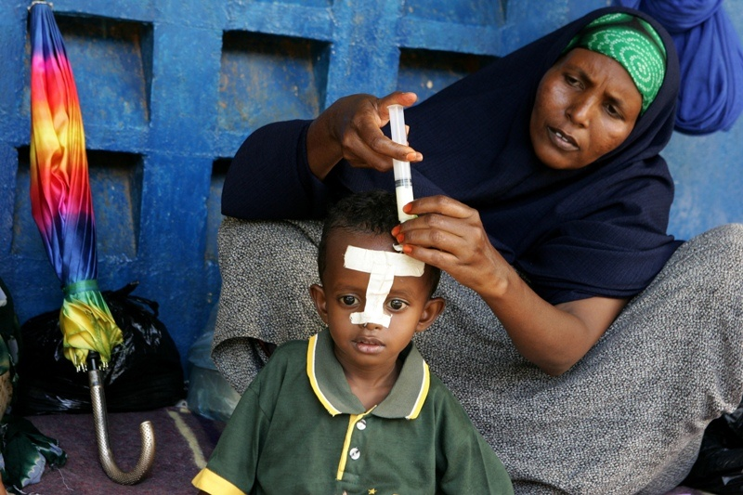
Stabilisation Phase … Step 7
NASO GASTRIC TUBE
  patient not taking sufficient amount (less than 75%)
  Pneumonia with rapid respiration rate
  Mouth lesions
  Cleft palate or other physical deformity
  Disturbance of consciousness
STEP 7: Cautious feeding
Each day try to give F75 by mouth before using NG tube
NG tube feeding should not exceed 3 days and is only used in Stabilisation Phase

Slide 35
Handout 2c
Summary of routine medication for in-patient treatment of severe acute malnutrition

Slide 36
SURVEILLANCE
Surveillance Tasks | Frequency
Take body temperature | Twice per day (four times a day for hypothermic or febrile children)
Weigh the child at fixed times | Daily
Assess and record the degree of edema (0 to +++) | Daily
Record the patient’s fluid intake and source (oral, NG tube or IV fluids). Record if the patient is absent at mealtime, has refused diet or has vomited. | Daily
Assess standard clinical signs (number of stools passed, vomiting, dehydration, cough, respirations, liver size, eyes, ears, skin condition and peri-anal lesions) | Daily
Full Medical Examination | Daily
Take MUAC | Every seven days
Measure height or length (length for children less than 87 cm) | Every twenty-one days (21), with each new Multi-chart
STABILISATION PHASE

Slide 37
CRITERIA FOR TRANSFER FROM PHASE 1 TO TRANSITION PHASE
Appetite has improved and taking all prescribed quantity of milk.
Oedema, if present, reduced from severe +++ to moderate++ or mild +.
Treatment for any medical complication has commenced and patient is recovering.
IV fluids and NG feeding completed and cannula / tube removed.
STABILISATION PHASE

Slide 38
Questions?
Notes:
You can now stop and take questions from the audience.

Slide 39
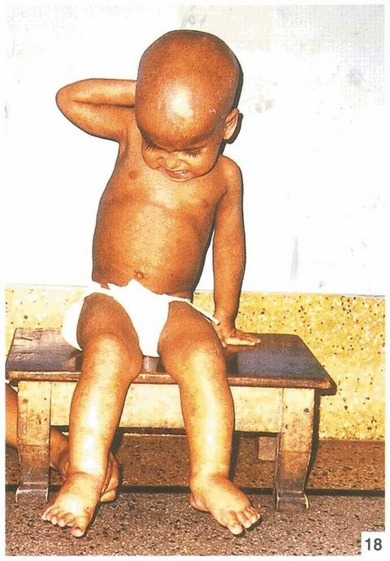
TRANSITION PHASE
Nutrition Support
Routine Medicine
Surveillance

Slide 40
TREATMENT OVERVIEW
Gradual catch up growth by increasing calorie intake
The volume, number, and timing of the feeds remains the same as Stabilisation , but the F75 is replaced with F100 or RUTF.
The clinical condition, especially signs of heart failure, should be carefully monitored to ensure the child is adjusting well to the new diet.
A patient usually remains in Transition Phase for 2-3 days.
overview
TRANSITION

Slide 41
feeding patterns
The decision whether to give specialized milk or RUTF depends on:
  Patient's discharge plan and
  Availability of specialized foods.
F75 is replaced by either F100 or equivalent made-up milk, ready to use therapeutic food (RUTF),or a combination of the two.
RUTF is offered first at every feed and is complemented with F100 if needed.
Nutrition Support
TRANSITION

Slide 42
DIET AND FREQUENCY
In contexts where an Out Treatment Program exists, transition phase should be used for the introduction of RUTF, in the 2nd step after introduction of F100.
  Transition Day 1: F100
  Transition Day 2: F100 for one meal RUTF for next meal OR morning F100 and afternoon RUTF
  Transition Day 3: RUTF only if the beneficiary accepts it well.
The use of RUTF requires that important quantities of safe drinking water are available for the beneficiary consuming it.
Nutrition Support
TRANSITION

Slide 43
Transition - Feeding plan
Appetite recovers
Admission
130 mls/kg/day as 3 - 4 hourly feeds for 2 – 3 days
F100, same volume as F75
F75
Notes:
43
At the return of appetite initially the feed is changed but the total volume of feed remains the same, 130mls/kg/day.
The recovery formula is more energy and protein dense so although the volumes have not changed the calorie and protein intake have increased considerably.
The child should receive this volume of F100 for 2-3 days and their progress monitored.
Remember the child can and should breast feed as often as it can as well.

Slide 44
PREPARATION OF F100:
Refer to Aux slide on milk preparation
TRANSITION

Slide 45
Surveillance
Surveillance Tasks | Frequency
Take body temperature | Twice per day (four times a day for hypothermic or febrile children)
Weigh the child and record the weight on Multi-chart | Daily
Assess and record the degree of edema (0 to +++) | Daily
Record the patient’s diet intake. Record if the patient is absent at mealtime, has refused diet or has vomited. | Daily
Assess standard clinical signs (number of stools passed, vomiting, dehydration, cough, respirations, liver size, eyes, ears, skin condition and peri-anal lesions) and note in the Multi-chart | Daily
Full Medical Examination | Daily
Take MUAC | Every seven days
Measure height (length) | Every twenty-one days (21), with each new Multi-chart
TRANSITION

Slide 46
TRANSFER BACK TO STABILISATION PHASE IF:
• Increasing or developing bilateral pitting edema
• Rapid increase in liver size
• Any signs of fluid overload
• Tense abdominal distension
• The patient gets significant re-feeding diarrhea so that there is weight loss.
TRANSITION

Slide 47
CRITERIA FOR TRANSFER TO PHASE 2
Good appetite (75% of prescribed feed)
Loss of oedema
Medical complications resolved.
Criteria for Transfer to OTP
Discharge to out-patient treatment of acute malnutrition is
only advised when the patient tolerates at least 75% of the amount of RUTF calculated for the individual child
Carer is willing and accepts outpatient care and come back on a weekly basis for follow-up.
TRANSITION

Slide 48
RE-FEEDING SYNDROME
Refers to acutely malnourished patients (and those who have been fasting for more than one week) who develop any of the following shortly after they have a rapid, large increase in their food intake
Floppiness, iv. Neurological symptoms
Lethargy v. Acidosis
Delirium

Slide 49
RE- FEEDING SYNDROME
Caused by rapid consumption of key nutrients for metabolism if diet is un balanced
Causes reduction in plasma phosphorous , potassium and magnesium

Slide 50
PREVENTION OF RE-FEEDING SYNDROME
Do not force feed malnourished children on admission more than prescription
Children with deteriorating status to be returned to stabilization phase
Diet should contain sufficient pottasium and magnesium

Slide 51
Plans for Eventual Out-Patient Care
Use RUTF if available. Alternate with F100 and transit to fully if well tolerated
Patients should drink as much water as possible while taking and after consumption of RUTF.
Routine antibiotic therapy should be continued for 4 days after Phase 1 or until the patient is transferred to the community nutrition care.
Patients being discharged from Transition Phase do not need to be given antibiotics on admission into the out-patient community nutrition care.
Antihelmiths are administered to malnourished children who are one year or older on transfered to either Phase 2 in-patient, or to out-patient.
TRANSITION

Slide 52
QUESTIONS?

Slide 53
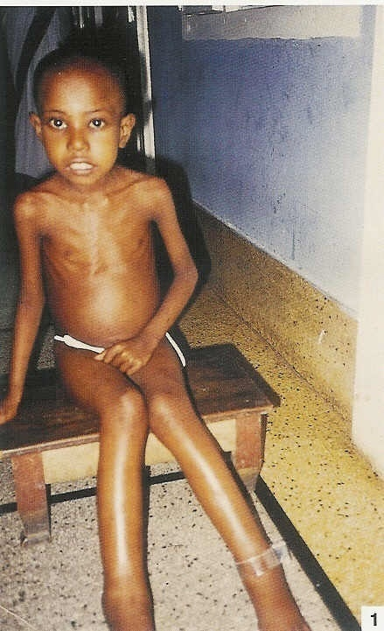
PHASE 2
Nutrition Support
Routine Medication
Surveillance
Discharge
Medications to Administer on Discharge
Failure to respond
Follow-up

Slide 54
Overview
This is the stage where weight-gain should start to occur
This amounts are the base – the child should be offered more if desired (feeds unlimited)
Breastfeeding encouraged to continue
A porridge meal can be added once the child is gaining weight well in this phase
Step 8: Achieve catch-up growth
REHABILITATION PHASE

Slide 55
Overview
F100 or RUTF can be used, both giving around 200 kcal/kg/day
Amount
F100= an average of 200 ml/kg/day in 6 feeds (see chart)
F100= a range of 150ml-220ml/kg/day is used freely
RUTF= look up chart
free feeding/unlimited feeding is carried out systematically beginning with 150ml/kg with gradual increase of 10ml/feed in the next feed if the previous one was all taken.
Step 8: Achieve catch-up growth
REHABILITATION PHASE

Slide 56
A feeding plan
Phase 2:
Good appetite, clinically stable
Transition: Appetite recovers
Phase 1: Admission
F100, volume increasing until appetite satisfied
F100, same volume as F75
F75
Notes:
56
If the a child remains clinically stable with a good appetite after 2-3 days of F100 at starting volumes then the total volume of feed can be increased.
This increase can be achieved by:
On about the 3rd day increase each feed by 10mls (so if fed 3 hourly the feed volume could go up by a maximum of 80mls over 24 hours)
Check if the child finishes all the feed – they should no longer be tube fed. If the child fails to complete a feed then the volume stopped at is the volume to offer each time the child is fed.
If the child starts to finish these new volume feeds then offer more.
The process of offering more can be repeated as the child now regulates their own intake.

Slide 57
DIET AND FREQUENCY
Frequency of meals and some of the routine surveillance is less frequent as in Stabilization Phase and Transition Phase
The main change in the diet is an increase in the amount of F100 or made-up milk formulas. (handout 2d)
The volume of milk is increased from 130ml/kg/day to 200ml/kg/day (equivalent to 200kcal/kg/day).
If the child remains hungry after completing a feed, more milk can be offered to achieve catch-up growth.
Either F100 or RUTF can be given, or a combination of both.
Step 8: Achieve catch-up growth
REHABILITATION PHASE

Slide 58
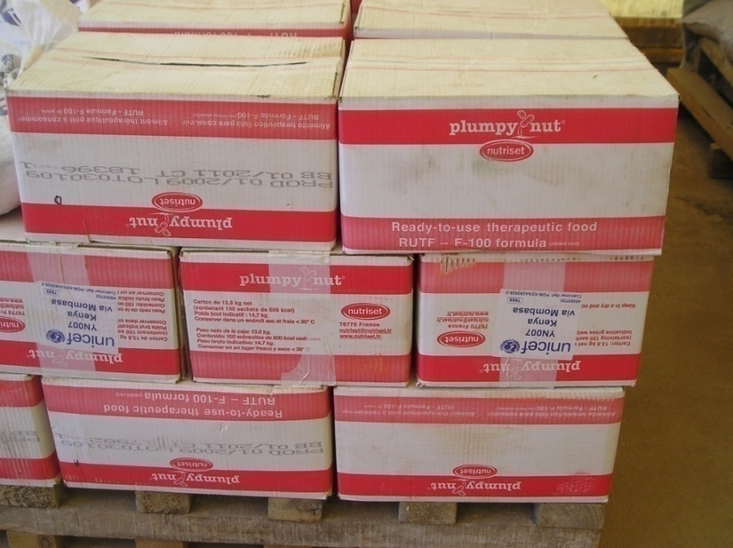
ROUTINE MEDICATION
Iron
Iron is given to malnourished children in Rehabilitation Phase.
For convenience and ease for staff it is crushed and added to the F100 diet or locally made-up mix.
RUTF already
contains the necessary
iron.
Step 8: Achieve catch-up growth
REHABILITATION PHASE

Slide 59
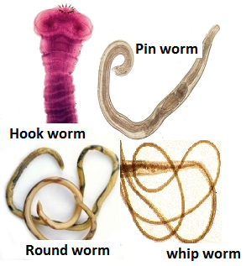
Routine medication: De-worming
De-worming is necessary for in-patient malnourished children, but should be delayed until patients recover in Rehabilitation phase discharged to OTP.
Children younger than one (1) year old should not receive anti-helminths.
REHABILITATION PHASE

Slide 60
CARING PRACTICES
Provide:
Tender loving care
A cheerful, stimulating environment
Structured play therapy 15-30 minutes per day
Physical activity as soon as the child is well enough
Maternal involvement when possible
(e.g. comforting, feeding, bathing, play)
Step 9: provide sensory stimulation and emotional support
PHASE 2

Slide 61
CARING PRACTICES
In severe malnutrition there is delayed mental and behavioural development.
All severely malnourished children should be admitted with the caregiver.
Severe malnutrition negatively affects psychosocial development.
Step 9: provide sensory stimulation and emotional support
PHASE 2

Slide 62
Surveillance
In Phase 2 monitoring is less intensive and less frequent than during Stabilisation Phase and Transition Phase.
Surveillance Tasks | Frequency
Take body temperature | Twice per day (four times a day for hypothermic or febrile children)
Weigh the child and record the weight on Multi-chart | Daily
Assess and record the degree of edema (0 to +++) | Daily
Record the patient’s diet intake. Record if the patient is absent at mealtime, has refused diet or has vomited. | Daily
Assess standard clinical signs (number of stools passed, vomiting, dehydration, cough, respirations, liver size, eyes, ears, skin condition and peri-anal lesions) and note in the Multi-chart | Daily
Full Medical Examination | Daily
Take MUAC | Every seven days
Measure height (length) | Every twenty-one days (21), with each new Multi-chart
REHABILITATION PHASE

Slide 63
PREPARATION FOR DISCHARGE
Throughout, keep the patient's family informed of the patient's progress and the discharge plan.
Schedule routine health and nutrition education in groups and individually as necessary.
If possible, during Phase 2 conduct cooking demonstrations with caregivers on how to use local foods and maintain balanced diets.
Discharge patient to a Supplementary Feeding Programme (SFP) if available and with a food ration if possible.
If there is no SFP, schedule a follow-up visit to the mother and child health clinic (MCH)
Discharge
PHASE 2

Slide 64
MEDICATIONS TO ADMINISTER ON DISCHARGE
One dose of Vitamin A.
Measles vaccine if the patient is older than 6 months (should be a month apart from the measles vaccine that was given on admission).
Discharge
PHASE 2

Slide 65
DISCHARGE CRITERIA
A good appetite: if the child passes the appetite test and takes 75 percent of the daily ration of RUTF
Bilateral pitting edema reducing to moderate (+ +) or mild (+)
Resolving medical complication
Clinically well and alert
Abandoned children can remain in patient care for rehabilitation phase
Discharge
PHASE 2

Slide 66
TRANSFER BACK TO REHABILITATION PHASE
At ANY time during the treatment, the child should be transferred back to the cautious feeding stage (Step 7) if:
• Increasing or developing bilateral pitting edema
• Rapid increase in liver size
• Any signs of fluid overload
• Tense abdominal distension
• The patient gets significant re-feeding diarrhea so that there is weight loss.
Failure to respond
PHASE 2

Slide 67
TRANSFER BACK TO REHABILITATION PHASE
A complication that necessitates an intravenous infusion
A need for feeding by NGT
Weight gain of more than 10 g/kg bodyweight/day in association with an increase in respiratory rate (indicative of excess fluid retention)
If a severe medical complication becomes apparent, such as hypothermia, hypoglycaemia

Slide 68
FAILURE TO RESPOND
Primary Failure to Respond | Time After Admission
Failure to regain appetite | Day 4
Failure to start to lose edema | Day 4
Edema still present | Day 10
Failure to gain at least 5g/kg/day of bodyweight | Day 10
Clinical deterioration AFTER admission | At any time
Secondary Failure to Respond
Failure to gain at least 5 g/kg/day of bodyweight | During Rehabilitation Phase for 3 successive days
Failure to respond
PHASE 2

Slide 69
Action –check if
night feeds are being given (for cautious feeding stage),
especially if children not taking all during the day.
That milk consumption, vomiting, diarrhoea, etc is being monitored properly.
Anthropometric equipment and measurements are accurate
Quality of care given by staff.
Specific micronutrient deficiencies and untreated infections.
HIV/AIDS .
Psychological problems
Failure to respond
REHABILITATION PHASE

Slide 70
Advice caregiver to
At discharge discuss and advise the carer on appropriate feeding and caring practices
Give structured play therapy
Where facilities exist, refer to a supplementary feeding program (SFP)
Ensure vitamin A is given every 6 months
Ensure booster immunizations are given
Advise to bring the beneficiary for regular follow-up checks
If there is no SFP, refer the child back to the local clinic for continued nutrition counselling and follow up by community workers
Step 10: follow up after recovery
PHASE 2

Slide 71
QUESTIONS?

Slide 72
Requirements for setting up an in-patient care
Material and equipment
Staff
Documentation
( see list of requirements for details)

Slide 73
Materials and Equipment
Therapeutic milks and ready
to use therapeutic foods (RUTF)
Medicines and medical equipment
Anthropometric equipment
Laboratory and diagnostic services (important but not essential).

Slide 74
TREATMENT AREA
Paediatric ward/ Inpatient ward with 24 hour care
Special area for secluding admitted malnourished children
Room temperatures of 25-30 C
Adult beds/ Mattresses on floor preferred to cots

Slide 75
STAFF
Personnel fully trained in Management of Acute Malnutrition with medical complications

Slide 76
MATERIALS AND EQUIPMENT
Records
Register book – MoH 368– is a record of all patients admitted for in-patient care.
In-Patient, OTP & SFP Facility Summary Sheet (MOH 713) -
Multi-chart- is the primary tool suggested for recording all information while managing the child with SAM..
24 hour intake and output chart (
In-patient to Out-patient care Transfer Form
Diet and Drugs and other materials
Infection Control

Slide 77
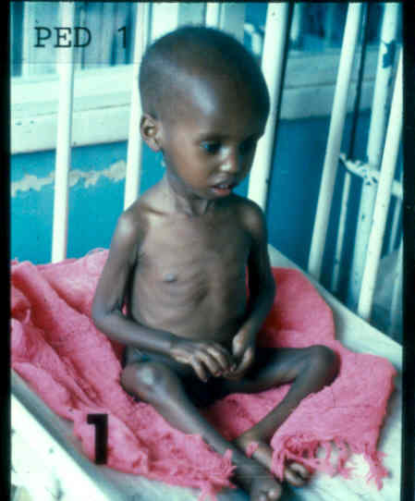
TREATMENT OF MEDICAL COMPLICATIONS
Hypoglycaemia
Hypothermia
Dehydration
Septic (Toxic) shock
Absent Bowel Sounds, Gastric Dilatation, Abdominal Distension
Heart Failure
Severe Anemia

Slide 78
Hypoglycaemia
Describe condition

Slide 79
CLINICAL SIGNS
Low body temperature (36.5 C)
Lethargy or limpness
Possible loss of consciousness
Drowsiness
Eyelid retraction. If a child is sleeping with his eyes slightly open, wake the child up and give sugar-water to drink.
Hypoglycaemia

Slide 80
Hypoglycaemia
TREATMENT/ MANAGEMENT
All children who have travelled long distances to attend a health centre should be given sugar-water as soon as they arrive
Children who have hypothermia or septic shock should be given 50-100ml of sugar water, whether or not they have low blood glucose.
A child who has taken the prescribed quantity of F75 diet each day (with 5-6 feedings per day) will not develop hypoglycaemia overnight and does not need to be woken for night time feeding.
If the diet is not completely taken during the day (due to vomiting or refusal of milk), encourage the caregiver to give at least one prescribed quantity of F75 diet during the night.

Slide 81
TREATMENT/ MANAGEMENT
Patients who are conscious and able to drink are given about 50 ml (approximately 5-10ml/kg) of sugar-water (10% glucose: 1 heaped spoon of ordinary sugar in 50mls of potable water). Or they can orally be given F75 diet or F100 if available. The actual amount given is not critical.
Patients losing consciousness are given 50 ml (or 5-10ml/kg) of sugar-water by NG tube immediately. When consciousness is regained, give milk feed frequently.
Unconscious patients are given sugar-water by NG tube. They should also be given glucose as a single intravenous injection (5ml/kg of a sterile 10% glucose solution).
All severely malnourished patients with suspected hypoglycaemia should be treated with broad spectrum Antibiotics.
Hypoglycaemia

Slide 82
Monitoring:
The patient response to treatment should be dramatic and rapid. If a very lethargic or unconscious patient does not respond, it indicates a different cause for the clinical condition
If consciousness drops, or temperature falls, re-test the blood glucose level and give another dose of glucose 50ml by NG tube or IV.
Close monitoring of feeds
Prevention:
Make sure that the severely malnourished patient receives sugar water on admission,
Make sure that the patient receives sugar water if waiting in the casualty or emergency department for over one hour.
For patients at risk of hypoglycaemia, give frequent, regular feeds every 3 hours.
Hypoglycaemia

Slide 83
Hypothermia
Describe condition

Slide 84
Clinical signs:
A rectal temperature below 35.5ºC, or an underarm temperature below 35ºC.
Treatment:
Do not bathe severely malnourished patients on admission, but, later when the patient is stabilized, under warm conditions
Use the “kangaroo technique” for children with a caretaker.
Put a hat on the child and wrap mother and child together.
Offer hot drinks for the mother to drink to keep her skin warmer
Prevention:
Do not bathe severely malnourished patients on admission, but, later when the patient is stabilized and under warm conditions
Hypothermia

Slide 85
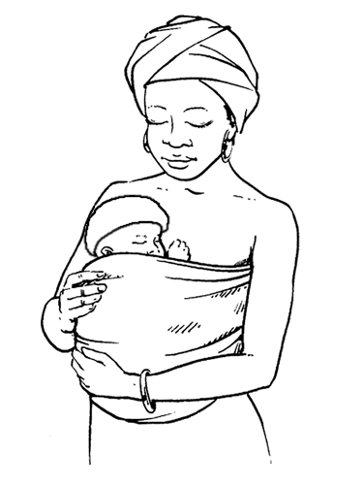
KANGAROO CARE
Kangaroo care means keeping an
infant in continuous skin to skin contact with the mother or adult caregiver.
The infant is held close against the mothers bare chest by wrapping a culturally appropriate cloth
The mother removes inner clothing and only wears usual outer clothing to keep warm
Hypothermia

Slide 86
KANGAROO CARE
The infant’s hands should be left free so he or she can move them in or out of the warmth.
Cover the infant´s head with a cap or the mother’s shawl, to reduce heat loss when very cold, .
Hypothermia

Slide 87
Monitoring:
Monitor a patient's body temperature during re-warming.
The room should be kept warm, especially at night (between 28oC and 32oC).
Treat for hypoglycaemia and give second-line (broad spectrum) antibiotic treatment.
NOTE
The thermo-neutral temperature range for malnourished patients is 28oC to 32oC.
Children should sleep with their mothers or caregivers and not in the traditional hospital child-cots/cages.
Hypothermia

Slide 88
Dehydration and SEPTic shock
Describe condition q

Slide 89
SIGNS
History of acute watery diarrhoea
Thirst
Hypothermia
Sunken Eyes
Weak or absent radial pulse
Cold hands and feet
Diminished urine flow
dehydration

Slide 90
UNRELIABLE SINGS OF DEHYDRATION
Mental State
Mouth , tongue and tears
Skin elasticity: The skin flattens very slowly when pinched, or may not flatten at all
dehydration

Slide 91
Diagnosis of Dehydration with the Marasmic Patient
  Do NOT use the skin pinch test to diagnose dehydration in malnourished children.
  Do NOT assume that marasmic patients who have sunken eyes are dehydrated. Marasmic eyes are normally sunken regardless of dehydration.
  Do NOT make a definitive diagnosis of dehydration. If the child seems to be dehydrated, make a provisional diagnosis and observe the response to treatment before confirming the diagnosis.
dehydration

Slide 92
Diagnosis of Dehydration with the Marasmic Patient
The diagnosis is determined by the patient's history rather than by examination. There needs to be:
  A definite history of significant and recent fluid loss. Usually this is a watery diarrhoea (not just soft or mucus), frequent, and with a sudden onset within the past few hours or days.
  There should also be a history noted of a recent change in the child’s appearance.
  If the eyes are sunken, the caretaker must be able to report that the eyes have become sunken since the diarrhoea started.
  The child has dry mouth, dry tongue with thick saliva and experiencing extreme thirst.
dehydration

Slide 93

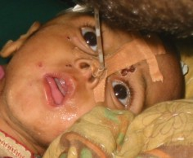
Diagnosis tree
Eyes Sunken
Not recent
Recent onset
Not dehydrated
Conscious
Unconscious
Sleeping
Awake
Eyes not closed
Eyes closed
Eye-lid retracted
Eye-lid normal
Eyes not closed
Eyes closed
Dehydration or
Hypoglycaemia
Mild/Mod
Dehydration or
Hypoglycaemia
Mild/Mod
Dehydration or hypoglycaemia
Mild/moderate
Notes:
The muscle that retracts the eyelid – levator palpebrae superioris – has a dual innervation. Voluntary cranial nerve and sympathetic nervous system (think about Horner’s syndrome – the drooping eye is due to loss of sympathetic tone, and of thyrotoxicosis where the sensitivity to adrenalin is increased), it is the sympathetic system that sets the TONE of the eyelid. If the sympathetic system is overactive – fright, dehydration, hypotension, hypoglycaemia are all causes – the eyes become staring or do not close properly when asleep/unconscious

Slide 94
Management protocol for a severely malnourished dehydrated child:
With severe malnutrition, the “therapeutic window” is narrow: dehydrated children can quickly go from having a depleted circulation to experiencing over-hydration with fluid overload and cardiac failure.
IV infusions are rarely used in both malnourished children because there is a particular renal problem that makes the children sensitive to salt (sodium) overload and at high risk of fluid overload.
If there is no dehydration, do not treat diarrhoea with rehydration fluids with the intention to prevent the onset of dehydration. This will again lead to over-hydration and heart failure.
dehydration
Notes:
An over- supply of ReSoMal can lead directly to heart failure, as well as failure to lose re-feeding oedema with the commencement of re-feeding

Slide 95
Before starting any rehydration treatment:
  Take and record the child’s pulse
  Weigh the child
  Record the child's respiration rate
  Mark the edge of the liver and the costal margin on the skin with an indelible marker pen (skilled staff).
  If the staff is qualified to do so, record the patient's heart sounds (presence or absence of gallop rhythm).
dehydration

Slide 96
Treatment of Dehydration for the Marasmic Patient:
When possible and feasible, rehydrate the patient orally with ReSoMal. Intravenous infusions are dangerous and not recommended unless there is:
  Severe shock with loss of consciousness from confirmed dehydration
The marasmic dehydrated child is entirely managed by:
  Weight changes
  Clinical signs of improvement e.g. alertness
  Clinical signs of over-hydration (engorged veins, rapid pulse, respiratory distress)
dehydration

Slide 98
Oral rehydration solution for SAM (ReSoMal)
SAM deficient in Pottasium with high Sodium levels
Rehydration solution should contain less sodium and more
Potassium, ORS is not recommended
Key elements: Magnessium, Zinc and Copper

Slide 99
ReSoMal Specifications and Dosage
Per 1 L constituent | Standard Osmolarity ORS | Low-Osmolarity ORS | ReSoMal
Sodium | 90 mmol | 75 mmol | 45 mmol
Chloride | 80 mmol | 65 mmol | 70 mmol
Potassium | 20 mmol | 20 mmol | 40 mmol
Citrate | 10 mmol | 10 mmol | 7 mmol
Glucose/Saccharose | 111 mmol | 75 mmol | 125 mmol
Osmolarity | 251 mmol/l | 245 mmol/l | 294 mmol/l

Slide 100
ReSoMal Specifications and Dosage
Not to be given to suspected cases of profuse watery diarrhoea or cholera
Give between 70 and 100ml/ kg of body over 12 hours
For children from septic shock treatment with IV fluids, omit first two hours and give for upto 10 hours
Assess child every hour and stop if: Respiratory and pulse rates increase, jugular veins become engorged and oedema increases

Slide 101
Steps for treating dehydrated Marasmic patient:
Step 1: Determine 5% of patient's body weight
A severely dehydrated marasmic child will lose a maximum of 5% of body weight only replace a maximum of this amount to avoid over-hydration
To determine 5% of body weight, equate: body weight in grams x 5%
dehydration
Example:
For a child that is 4kg, 5% body weight of the child equals:
4000g x 5/100 = 200gm
which then equates to 200ml of re-hydration fluid.

Slide 102
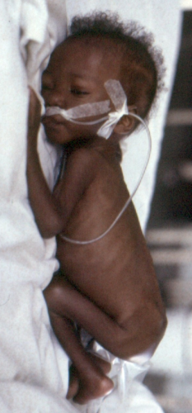
Step 2:
Administer re-hydration fluid
The fluid must be given slowly over time to prevent complications such as overload or heart failure.
Give ReSoMal orally or by NG tube (handout 2e)
Give: 5ml/kg every 30 minutes for first two (2) hours
Give 5-10mls hourly until weight gain has been achieved
dehydration

Slide 103
Example:
For a 4kg child, over the first two hours give the following orally or by NG tube:
5ml/kg ReSoMal every 30 minutes for two hours = 20ml x 4 (there are four 30 minute intervals in two hours) = 80ml. (This is 2% of a 4kg child's body weight).
Over the next number of hours give 5 to 10 ml/kg/hour ReSoMal until weight gain is achieved and the patient shows clinical signs of improvement.
Therefore for a 4kg child, give 20 to 40ml per hour after the initial two hours.
dehydration

Slide 104
Step 3: Complete the re-hydration
Give re-hydration fluid until the weight deficit (measured or estimated) is corrected. Stop as soon as the child is re-hydrated, having reached the target rehydrated-weight.
As the child gains weight during re-hydration, definite clinical improvement should be obvious. The signs of dehydration should disappear.
If there is no improvement with weight gain, the initial diagnosis of dehydration was wrong and rehydration therapy must be stopped.
dehydration

Slide 105
Step 4: After re-hydration
After rehydration, usually no further treatment is given.
However, for SAM children from 6 to 24 months, 30ml of ReSoMal can be given for each incidence of a watery stool.
NOTE:
The standard instructions to give 50-100ml for each stool should not be applied. It may cause fluid overload.
dehydration

Slide 106
Two hours after commencing re-hydration therapy, make a major medical reassessment.
  Check all vital signs
  Check heart sounds
  Check for clinical signs of respiratory distress.
  Check consciousness levels and weight gain.
  Check for vomiting and/or diarrhoea.
  Based on weight assessment after 2 hours of re-hydration, appropriate action is taken (handout 2f)
dehydration

Slide 107
Specific Intravenous Rehydration for SAM
IV infusions used when there is circulatory collapse or shock due to severe dehydration or shock
A child with shoul receive:
one bolus of 5 ml/kg of sterile 10% glucose IV, and 15 ml/kg IV fluids for 1-2 hours, and oral or nasogastric dose of ReSoMal alternated with F-75 in the following 10 hours.

Slide 108
Specific Intravenous Rehydration for SAM
Use one the IV solutions in order of preference:
1. half-strength Darrow’s solution with 5% glucose (dextrose)
2. Ringer’s lactate solution with 5% glucose
3. ( 0.45% (half-normal) saline with 5% glucose is used if neither of the above is available If possible, add sterile potassium chloride, 20 mmol/l.

Slide 109
Administration of Intravenous Rehydration
Give 15ml/kg over 1 hour and monitor for signs of rehydration
While the IV drip is being set up, also insert an NG tube and give ReSoMal through the tube (10 ml/kg per hour)
If respiratory and pulse rates fall, repeat treatment and then switch to ReSoMal orally or NG tube (10 ml/kg per hour) upto 10 hours
Alternate with F-75 feeds
If no improvement after first IV with absence or radial pulse, start treatment for septic shock

Slide 110
Diagnosis of Shock from dehydration
The Marasmic patient is going into shock when:
  There is definite dehydration determined by the patient's history and the medical examination, AND
  There is a weak or absent radial or femoral pulse, AND
  The patient has cool or cold hands and feet (check with back of hand gently for five seconds).
  The patient is going into severe shock when, in addition to the above signs, there is a decrease in the level of consciousness, the patient is semi-conscious or cannot be roused.
  Slow capillary refill
dehydration

Slide 111
Feeding During Rehydration
Continue Breastfeeding
Give F 75 orally or by NG tube within 2-3 hours of starting rehydration
If child is alert and drinking, give F75 immediately
ReSoMal is given at alternate hours to feeding
Use NG tube for vomiting child

Slide 112
Risk of Congestive heart Failure
Due to over hydration when using IV infusion or undiluted ORS solution, severe aneamia, blood transfusion, high sodium diet
Signs include: fast breathing, distenstion of jugular veins, respiratory distress, cold hands and feet, cyonosis finger tips and tongue
Occurs after more than 48 hours of treatment

Slide 113
Management of fluid overload heart failure
Stop all oral IV fluids including feeding the child
Give Diuretic (Furosemide)
Do not give digitalis unless heart failure is unequivocal

Slide 114
TREATMENT OF SHOCK
If the patient is definitely dehydrated (a history of fluid loss, a change in the appearance of the eyes), and shows all of the following:
  Semi-conscious or unconscious and
  Rapid weak pulse and
  Cold hands and feet
Then the patient should be treated with intravenous fluids.
The amount of IV fluid given is half or less of that used for nourished, dehydrated children.
dehydration

Slide 115
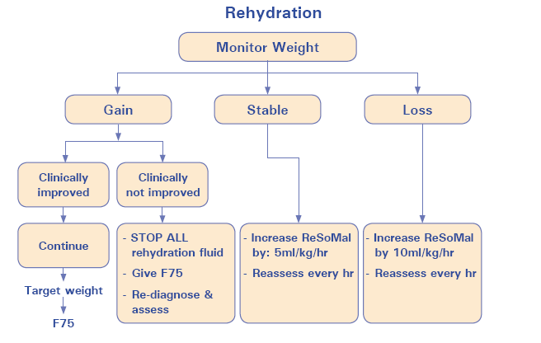
dehydration

Slide 116
MONITORING
Rehydration therapy must immediately stop if any of the following are observed:
The target weight for rehydration is achieved (start F75)
Visible veins are full (start F75)
The development of oedema (indicates over-hydration: start F75)
The development of prominent neck veins
The neck veins engorge when the abdomen (liver) is pressed
An increase in the liver size by more than one centimetre
The development of tenderness over the liver
An increase in the respiration rate by 5 breaths per minute or more
The development of a “grunting” respiration (this is a noise on expiration not inspiration)
The development of râles or crepitations in the lungs
The development of a triple rhythm.
dehydration

Slide 117
DIAGNOSIS AND TREATMENT OF DEHYDRATION FOR KWASHIORKOR PATIENTS
  Patients with bi-lateral oedema are over-hydrated and have increased total body water and increased sodium levels. These patients can thus not be dehydrated
  Oedematous patients are however frequently hypovolaemic.
  The treatment of hypovolaemia in kwashiorkor is the same as the treatment for septic shock
  If a child with kwashiorkor has watery diarrhoea, and is deteriorating clinically, then the fluid lost can be replaced on the basis of 30ml of ReSoMal per watery stool.
hypovolaemic

Slide 118
Causes of septic shock
Septic shock is caused by decreased tissue perfusion and oxygen delivery as a result of infection and sepsis.
Septic shock can cause multiple organ failure and death.
Children, immune-compromised individuals, and the elderly are most susceptible as their immune systems cannot cope with infection as well as healthy adults do.
Septic shock

Slide 119
Diagnosis of septic Shock
To diagnose septic shock, signs of hypovolaemic shock are present. There is a fast, weak pulse with all three of the following:
  Cold peripheries.
  Disturbed consciousness
  Absence of signs of heart failure
Septic shock

Slide 120
Signs of shock present
Fast weak pulse, cold peripheries, pallor, drowsiness
No History of recent eyes sinking
No history of major fluid loss
Eye-lid drooping/normal or closed when asleep/unconscious
Eye-lid retracted or slightly open when asleep/ unconscious
Septic shock with Hypoglycaemia
Septic shock
Note: Lid retraction without shock
– treat immediately for hypoglycaemia
Notes:
DO NOT diagnose septic shock just on the appearance of the child – most of these children are profoundly apathetic and appear to be drowsy and slow. There must be definite signs of shock present without signs of heart failure.
NOTE WELL THAT CARDIOGENIC SHOCK ALSO OCCURS and this can be part of sepsis – the children must be handled very gently and not required to take ANY unnecessary exercise during this time – do not take blood, send for X-ray, wash the child or disturb any more than absolutely necessary.

Slide 121
Treatment
All patients with signs of early or developed septic shock should immediately:
  Be given broad-spectrum antibiotics
  Therefore continue first-line antibiotic and add second-line antibiotics.
For developed septic shock: Consider third-line antibiotics, antifungal treatment and anti-staphylococcal treatment.
Iron supplementation should not be given
Septic shock

Slide 122
Treatment of Septic Shock
Compensated shock
Decompensated Shock
Prompt feeding on F75 to prevent hypoglycemia
NG tube diet (Most children anorexic)
IV rehydration immediately at 15ml/kg per hour
Observe for signs of over hydration or heart failure
Alternate ReSoMal and F75 once consciousness is regained
No feeding during blood transfusion
Give F75 after transfusion

Slide 123
anemia

Slide 124
Management of Anemia in SAM
Nearly all SAM children have anaemia
Children on F75 should receive 5mg of folic acid orally on day 1 and 1mg per day afterwards
Children in rehabilitation phase on F75 and gaining weight receive iron supplementation after 2 days of 3 mg/day
Iron and folic acid supplementation not given to children on RUTF

Slide 125
Management of Moderate and Severe Anaemia
Moderate Aneamia in Children: Give elemental iron 3mg/kg per day in two divided doses upto maximum of 60mg daily for 3 months
Give between meals using liquid preparation

Slide 126
Management of very severe anaemia
Diagnosis :Hb < 40g/l OR Packed cell vol<12%

Slide 127
Blood Transfusion
Give 10 ml of packed red cells or whole blood per kg of body weight slowly over 3 hours
Stop all feeding and fluids
Do not give iron during the initial phase of treatment
In case of life threatening heart failure and where testing for HIV and Viral Hepatitis B not possible and HB concentration is below 3 g/dl (or 30 g/l or packed-cell volume below 10%)

Slide 128
Blinding Eye Problems
Vitamin A not required for children with SAM on F-75, F-100, RUTF
When to supplement: Night blindness, Conjuctival xerosis with bitot’s spots, corneal xerosis or ulceration, keratomalacia, recent measles

Slide 129
Management of Vitamin A deficiency
High dose for first 2 days: 50,000 IU for infants less than 6 months, 100,000 IU for infants 6-12 months, or 200,000 IU for children above 1 year and third dose 14 days later

Slide 130
Vitamin A Systematic Treatment
Age | Vitamin A Oral for a patient with severe vitamin A deficiency on the first 2 days, followed by a third dose at least 14 days later.
< 6 months | 50,000 IU
6 to 11 months | One blue capsule (100,000 IU)
12 months and older | One red capsule or two blue capsules (200,000 IU)

Slide 131
Eye Examination
Tetracycline eye drops (1%) should be instilled four times daily until all signs of inflammation or ulceration resolve
Atropine eye drops (0.1%) applied
ocular inflammation or ulceration, protect the eyes with pads soaked in 0.9% saline and bandage eyes

Slide 132
Dermatosis
Signs: hypo- or hyperpigmentation, shedding of the skin in scales or sheets, and ulceration of the skin of the perineum, groin, limbs, behind the ears and armpits
Treatment: nystatin ointment or cream (100 000 IU (1 g)) twice daily for 2 weeks and oral nystatin (100 000 IU four times daily). Application of zinc, castor oil, petroleum jelly
Zinc supplementation

Slide 133
Persistent Diarrhoea
Occurs at least three times a day, every day for at least 14 days
If no dehydration, clinically well and with appetite, treat in OTP and receive low-osmolarity ORS to prevent dehydration
Give ReSoMal for child transferred to Inpatient

Slide 134
HIV Infection and SAM
All HIV exposed children should be tested for HIV status
Provider initiated counselling and testing should be routinely offered to all children
Treatment of SAM in HIV infected children is the same as in children who are HIV-negative
ART started after stabilisation and follow national protocol

Slide 135
Tuberculosis
Diagnosis: is based on clinical features, supported by chest X-ray and examination or culture of sputum or tracheal secretions

Slide 136
Simplified Clinical TB Diagnosis
Presence of2or more of the following symptoms Cough >2weeks Weightlossor poorweight gain Persistentfeverand/ornightsweats>2weeks Fatigue, reducedplayfulness, lessactive PLUS
Presence of 2or more of the following: Positivecontacthistory Respiratory signs Chest X raysuggestiveof pulmonary TB(where available) Positive Mantoux test(where available)
Then PTB is likely, and treatment is justified

Slide 137
Fever
Body temperature39.5° C
Give antipyretics. Paracetamols used with caution when high fever is causing distress

Slide 138
Administration of Medication
  Great care should be exercised in prescribing drugs to severely malnourished patients.
  Severely malnourished patients have: abnormal kidney and liver function; defective metabolism and absorption mechanisms
  It is strongly advised that severe malnutrition is treated first, before standard doses of drugs are given.
  Nutritional treatment returns the patient's metabolism to normalcy.

Slide 139
Exercise: Management of a Patient with Complications in In-Patient Care
  Handout 2i

Slide 140
Questions

