Slide 1
Integrated management of acute malnutrition
Republic of Kenya
Ministry of Health
Management of acute malnutrition in Infants less than six months

Slide 2
Overall Objective
To train health workers on the management of malnourished infants less than 6 months with or without the prospect of being breastfed

Slide 3
Learning Objectives
By the end of this Session, learners should be able to:
Identify and admit malnourished infants less than 6 months and infants less than 3kg
Know the criteria for admission and discharge of infants less that 6 months and less than 3 kg admitted in program
Manage malnourished infants less than 6 months in the in-patient care (for infants with/without prospects of being breastfed)
Implement Supplementary Suckling if breastfeeding is an option
Know how to care for a mother of malnourished infants less than 6 months

Slide 4
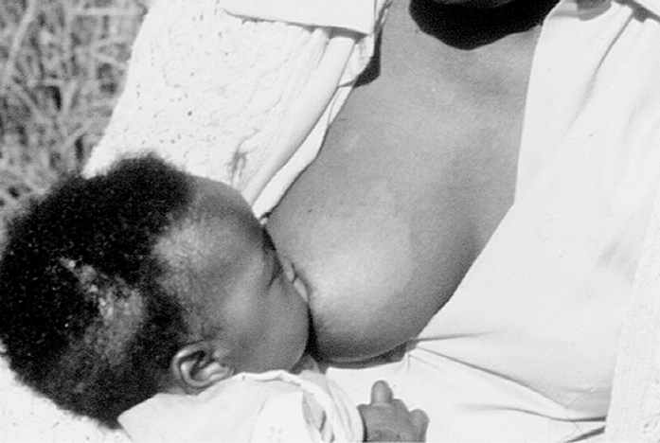
Infants Less Than Six Months with a Prospect of Being Breastfed

Slide 5
Overview
It is recommended that all mothers should exclusively breastfeed their infants for the first 6 month of life.
Mothers that are HIV positive need support and counselling on infant feeding options.
The objective of treatment of these malnourished infants is to return them to full exclusive breast feeding
Children under six (6) months with malnutrition should always be treated in an in-patient unit
Notes:
Exclusive breastfeeding means- only breast milk and no other fluids, syrups, water except medicines when prescribed

Slide 6

Why focus on malnourished breastfeeding infants?
Infants who are malnourished are weak and often do not suckle strongly enough to stimulate adequate production of breast milk.
Sometimes the mother thinks that “ she has insufficient breast milk” and is apprehensive about her ability to adequately feed the infant
It is important to put the infant to the breast as often as possible to stimulate milk production
Overview

Slide 7
Health Facility Requirements
Location: Infants should be breastfed and treated in a separate space from the older malnourished children
Structure: The area where these infants are managed should be adequately screened and private
Overview

Slide 8
Steps to admission for in-patient care
Step 1: Initial Screening and Referral:
Assessment of sub-optimal breastfeeding and care practices, growth faltering and illness
Step 2: Conduct a medical assessment to identify infants with emergency signs and immediately transfer to a qualified health worker for treatment taking into consideration the SAM specific protocols.
Overview

Slide 9
Steps to admission for in-patient care
Step 3: If no emergency signs are found, then conduct a medical assessment to determine if the child has any priority signs and treat accordingly taking into consideration the SAM specific protocols.
Step 4: Nutritional Screening at the Health Facility for Non-Urgent Cases
Step 5: Conduct a thorough medical assessment consisting of a physical examination and medical history
Overview

Slide 10
Steps to admission for in-patient care
Step 6: Assess Breastfeeding Practices
Breastfeeding assessment: frequency ,technique and duration on each breast.
Number of times baby is passing urine
Mode of feeding, e.g. breastfeeding, cup, cup and spoon, bottle
Feeding technique e.g. responsive, active, forced
Hygiene while preparing to breastfeed.
Psychosocial factors contributing to inadequacy of intake, such as social isolation, depression, stigma.
Use of vitamin and mineral supplements and alternative practices
Overview

Slide 11
Steps to admission for in-patient care
Step 7: Identify Underlying Cause of Acute Malnutrition
Step 8: Based on the above medical, nutrition and causal assessment, determine the management of the infant:
Overview

Slide 12
ADMISSION CRITERIA
Infants less than 6 months of age with a prospect of being breastfed
AGE | ADMISSION CRITERIA
Infant less than 6 months OR Infants ≥ 6 months but weighing less than 4kg being breastfed | Presence of bilateral pitting edema OR WFL < -3 z-score
 | OR
 | The infant is too weak to suckle or feed effectively (regardless of weight-for-length)
 | OR
 | IMCI danger signs; recent weight loss or failure to gain weight per WHO weight velocity standards

Slide 13
Nutrition support
To stimulate breast-feeding and to supplement the child until breast milk is sufficient to allow the child to grow properly.
To support infants who are too weak to breastfeed through Supplemental Suckling (SS) technique
Purpose

Slide 14
Nutrition Support
Prioritize establishing, or re-establishing effective exclusive breastfeeding
If an infant is not breastfed, support should be given to the mother or female caregiver to re-lactate
Where exclusive breastfeeding does not provide enough breast milk for the infant re-lactation should be supported and stimulated by supplemental suckling

Slide 15
Nutrition Support
Infants with SAM without edema should be supplemented with expressed breastmilk, a generic infant formula or F-100 diluted
Young infants with edema should be supplemented with expressed breastmilk or F-75 until the edema has resolved
Undiluted F-100 due should never be given to infants less than 6 months old with severe acute malnutrition
Overview

Slide 16
Nutrition Support
Feeding in In patient care
Breastfeed on demand or offer breastfeeding every 3 hours for at least 20
Between a half-hour and an hour after a normal breastfeeding session, give maintenance amounts of a milk supplement at 130 ml/kg/day distributed across eight feeds per day using the supplemental suckling technique
The quantity of milk supplement is not increased as the infant starts to gain weight.
Overview

Slide 17
Quantity and frequency of feeding Diluted F 100
Breast-feed every 3 hours for at least 20 minutes, more often if the child cries or seems to want more
Between one half and one hour after a normal breast-feed give maintenance amounts of F100 Diluted using the supplementary suckling technique
Nurse in a separate space from the older malnourished children to prevent cross infection
Nutrition Support

Slide 18
Quantity and frequency of feeding Diluted
F 100
The quantity of F100 Diluted is calculated depending on the body weight (handout 4a)
The quantity is NOT increased as the infant starts to gain weight
NOTE:
Children less than 6 months, with oedema, should be started on F75 and not F100 Diluted.
When the oedema has resolved and they are suckling strongly, change to F100 Diluted or infant formula
Infant formula is NOT designed to promote rapid catch–up growth
Unmodified powdered whole milk should NOT be used
Nutrition Support

Slide 19
Monitoring Feeding
The progress of the child is monitored by the daily weight:
In general the supplementation is not increased during the stay in the centre. If the child grows regularly with the same quantity of milk, it means the quantity of breast milk is increasing.
If after some days, the child does not finish all the supplemental milk, but continues to gain weight, it means that the breast milk is increasing and that the child has enough.
If the child looses weight over 3 consecutive days yet seems hungry and is taking all his F100 Diluted, add 5mls to each feed
Weigh the child daily with a scale graduated to within 10g (or 20g).
Nutrition Support

Slide 20
Nutrition Support
Quantity of F100 Diluted
Progress is monitored by the daily weight, and weight growth velocity.
If the infant loses weight or has a static weight over 3 consecutive days but continues to be hungry and is taking all the milk, progressively add 5 ml extra to each feed
The infant should be weighed daily with a scale graduated to within 10-20 grams.
Supplementation is not increased during the stay in the health facility.
Overview

Slide 21
Nutrition Support
Quantity of F100 Diluted
If the infant starts gaining weight, gradually decrease the milk supplement by one-third of the maintenance intake so that the infant is stimulated to take more breast milk.
If the weight gain is sufficient and maintained for 2–3 days stop the milk supplement. If the weight gain is not maintained, re-increase the amount of milk supplement to 75% of the maintenance amount for 2–3 days, then gradually decrease the amount again if the infant starts gaining weight

Slide 22
SUPPLEMENTAL SUCKLING (SS) TECHNIQUE
Supplementary Suckling Technique

Slide 23
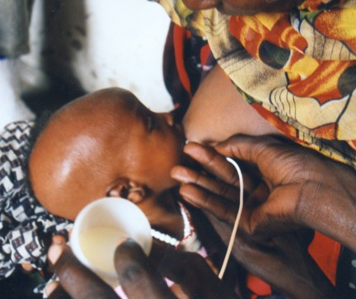
REQUIREMENTS FOR SS TECHNIQUE:
F100 diluted
Size n°8 NG tube – cut the tips beyond side ports (if they exist)
Cup to hold the milk
Nutrition Support

Slide 24
PROCEDURE FOR SS TECHNIQUE
F100 Diluted is put in a cup. The mother holds it.
The end of the tube is put in the cup.
The tip of the tube is put on the breast at the nipple and the infant is offered the breast in the normal way so that the infant attaches properly.
When the infant suckles, the milk from the cup is sucked up through the tube
Nutrition Support

Slide 25
PROCEDURE FOR SS TECHNIQUE
This infant is suckling the breast and also getting the F100 Diluted by the supplemental suckling technique.
At first an assistant needs to help hold the cup and the tube in place.
Nutrition Support
Assistant

Slide 26
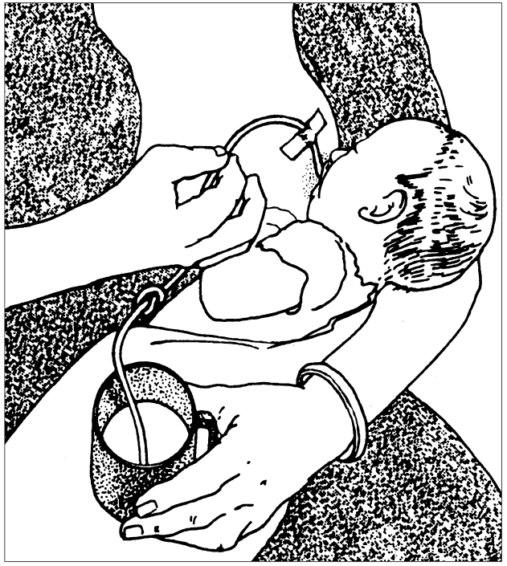
SUPPLEMENTARY SUCKLING TECHNIQUE
At onset of SS, the cup should be placed at about 5 to 10cm below the level of the nipple so the milk does not flow too quickly and distress the infant. And the weak infant does not have to suckle excessively to take the milk.
Raising or lowering the cup determines the ease with which the infant gets the supplement:
Nutrition Support

Slide 27
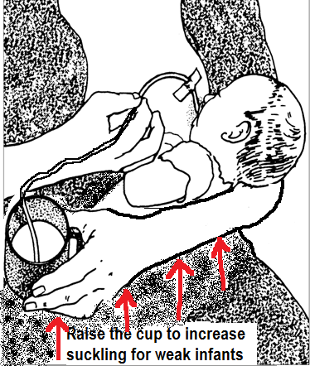
SUPPLEMENTARY SUCKLING TECHNIQUE
for very weak infants it can be at the level of the infant’s mouth.
If it is above this level, the feed can go into the child by siphonage with a danger of aspiration
As the infant becomes stronger the cup should be lowered progressively to about 30cm below the breast
Nutrition Support

Slide 28
Routine medication

Slide 29
Surveillance
Surveillance Tasks | Frequency
Take body temperature | Twice per day (four times a day for hypothermic or febrile children)
Weigh the child at fixed times | Daily
Assess and record the degree of edema (0 to +++) | Daily
Record the patient’s fluid intake and source (oral, NG tube or IV fluids). Record if the patient is absent at mealtime, has refused diet or has vomited. | Daily
Assess standard clinical signs (number of stools passed, vomiting, dehydration, cough, respirations, liver size, eyes, ears, skin condition and peri-anal lesions). | Daily
Full Medical Examination | Daily
Measure height or length (length for children less than 87 cm) | Every twenty-one days (21), with each new Multi-chart

Slide 30
Care for the Mother
Check mother’s MUAC and the presence of bilateral pitting edema.
Explain to the mother what the aim of treatment is and what is expected of her.
Do not make the mother feel guilty for the state of her child or blame her for giving other foods.
Strongly reassure the mother that the technique works and that she will produce enough milk herself to make her baby better.
Teach her how to express breastmilk and top to top up her infant with hind milk

Slide 31
Care for the Mother
Show her how to wake her baby who falls asleep in the middle of a feed so that they can feed some more and take in adequate calories.
Be attentive to her and introduce her to the other mothers in the in-patient facility.
She should drink at least two (2) litres of fluids per day.
She must eat enough - about 2500kcal/day (one porridge in the morning, one or two family meals, one porridge in the afternoon).

Slide 32
Care for the Mother
The mother who is admitted in the center with her child receives Vitamin A 200,000IU if the child is below 2 months old (there should be no risk of pregnancy)
Micronutrients’ supplementation must also be given to the mother
The mother’s diet is important for the recovery of the infant from malnutrition
The length of stay in the in-patient facility should be as short as possible

Slide 33

Discharge Criteria
Infants less than 6 months with a prospect of being breastfed
AGE | DISCHARGE CRITERIA
Infant less than 6 months or ≥ 6 months and less than 4kg being breast-fe | It is clear that he/she is gaining weight at 5g/kg/day for at least 3 consecutive days on breast milk alone after the Supplementary Suckling Technique has been stopped. AND Infant clinically well and alert AND
 | Infant has no medical problem and edema is resolved completely.
Note: There are no anthropometric criteria for discharge of the fully breast-fed infant who is gaining weight.

Slide 34
Follow-up
Enroll mother in SFP (if it exists) to receive high quality food ration in order to improve the quantity and quality of breast milk.
It is also important to monitor the infant’s progress:
  Support exclusive breastfeeding and
  Inform the mother on when to introduce appropriate complementary food after the age of 6months.
Monitor the growth of infant

Slide 35
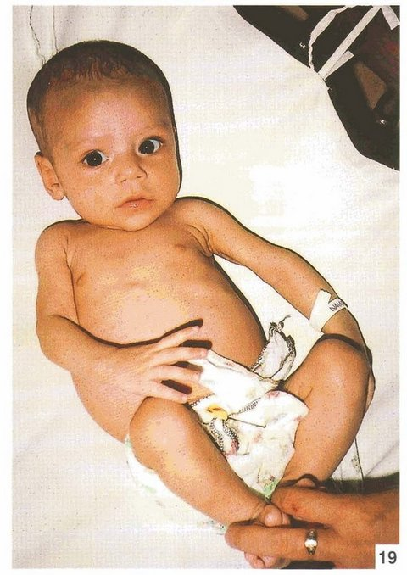
Infants Less Than Six Months without Prospect of Being Breastfed

Slide 36
Overview
Malnourished Infants who cannot be breastfed are treated according to the standard protocols of management of acute malnutrition:
  Phase 1: medical stabilization and nutrition rehabilitation
  Transition: Gradual weight gain
  Phase 2: Rapid catch-up growth

Slide 37
Instances Where Exclusive Breastfeeding is NOT Possible
Abandonment
Child being orphaned
HIV+ mother that can meet AFASS criteria for exclusive replacement feeding
Medical conditions e.g. mental health disorders
Notes:
AFASS- Acceptable, Feasible, Affordable, sustainable and safe

Slide 38
Admission criteria
AGE | CRITERIA
Infant less than 6 months or less than 4kg WITHOUT being breast-fed | Weight for length < -3 Z scores Or Presence bilateral oedema The infant is too weak to suckle or feed effectively (regardless of weight-for-length) OR IMCI danger signs; recent weight loss or failure to gain weight per WHO weight velocity standards

Slide 39
DIET AND FREQUENCY
Nutrition Support

Slide 40
DIET AND FREQUENCY
Criteria to progress
1. From the stabilization phase to the transition phase are both:
Return of appetite, and
Edema starts resolving
2. Transition phase to the rehabilitation:
  A good appetite
  Complete loss of bilateral pitting edema, or
  Minimum stay of 2 days in the transition phase, and
  No other medical problem
Nutrition Support

Slide 41
ROUTINE MEDICATION
Routine medicine is the same as for infants under six months who are breastfed

Slide 42
Surveillance
Surveillance is the same as for Stabilization phase, inpatient care

Slide 43
DISCHARGE CRITERIA
Infants less than 6 months without a prospect of being breastfed
AGE | DISCHARGE CRITERIA
Infant less than six months or ≥ 6 months and less than 4 kg with no prospect of being breast-fed | WFL (weight-for-length) > -2 z-score, and gaining weight at 20g/d AND No bilateral pitting edema for two weeks AND Clinically well and alert

Slide 44
DISCHARGE CRITERIA
At discharge infant can be switched to infant formula
Caregiver should been adequately counseled before discharge
The caregiver must have the knowledge and facilities to prepare the formula milk safely
Whenever formula milk is provided as part of management of severe acute malnutrition in infants, it should not confuse or compromise the wider public health message concerning exclusive breastfeeding for infants less than 6 months

Slide 45
Follow Up
Include other milks e.g modified animal milk to prevent relapse.
Nutrition counseling to the care taker
Test infant at 6 weeks of age for HIV if exposed
Refer for Prophylaxis and assess need for ART support
Monitor the growth of infant

Slide 46
Case studies
Handout 4C

Slide 47
questions

