Slide 1
Integrated management of acute malnutrition
Republic of Kenya
Ministry of Health
Community Approach for Nutrition Services

Slide 2
Overall Objective
To enable health workers establish and maintain effective community mobilization activities to support Nutrition services

Slide 3
Learning Objectives
By the end of this session, participants should be able to:
Appreciate the importance of community approach in IMAM services
Understand the goals of community mobilization
Understand process of community mobilization
Understand the process of setting up a referral system between the health facility and the community

Slide 4
Overview of Community Approach
Community Approach includes:
Empowering community with knowledge on malnutrition
Increasing access to and uptake of services
Active case finding and follow up of acute malnutrition cases through linkages between community and health facility
Promoting ownership and sustainability by community units

Slide 5
Objectives of Community Approach
Community mobilization helps health workers better understand the affected communities they're working in and is central to the success of the management of malnutrition.
The goals of community Approach:
Provide a link for the community and the existing health facilities
Create awareness on the treatment of malnutrition
Provide early detection for and treatment of malnourished individuals
Promote community participation
OVERVIEW

Slide 6
Where does Community Approach(C A) fit in?
C A is a component of the broader mobilisation for health service
C A is foundation of successful programme for management of acute malnutrition
Household members, community members and Community Health Workers (CHWs) should be involved in nutrition care and support for the malnourished
Community Approach focuses on enhancing community capacity to support nutrition care and rehabilitation of the patient
OVERVIEW

Slide 7
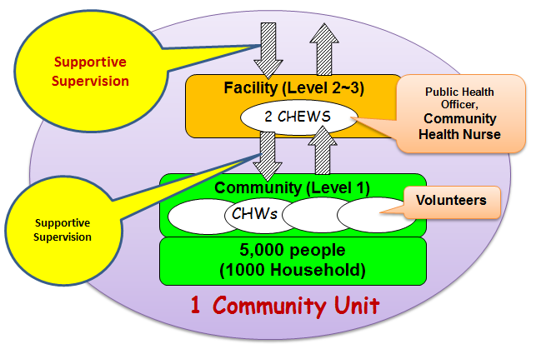
Community Representation and linkage to the health facility

Slide 8
Community approach for imam services
Process
Steps

Slide 9
PROCESS
There are two phases comprising of eight essential steps in using community approach for IMAM services:
Planning phase:
Step 1:Conducting a Community Assessment
Step 2: Formulating a Community Approach Strategy
Step 3: Developing Messages and Materials
Step 4: Conduct Trainings

Slide 10
Cont’d
Implementation phase:
Step 5: Conducting Community Mobilization and
On-going sensitization
Step 6: Conducting Case-Finding and Referral of New Cases with acute malnutrition
Step 7: Conducting Home Visits for Follow Up
Step 8: Linking with Other Community Support
Programmes

Slide 11
STEP 1: Conducting Community Assessment
Identifies factors likely to impact on service delivery and demand.
Carried out by Health worker in charge of IMAM services and Community Health Extension Worker
Objectives
What aspects of the community are likely to affect the demand for the IMAM services?
How can community approach be organized to meet the demand for the IMAM services most effectively?
Planning phase

Slide 12
Community Assessment Activities
Participatory engagement of community on its understanding of acute Malnutrition
Identify local terms, perceived causes and solutions
Information on social dynamics (Ethnicity, Religion, vulnerable groups)
Identification of communication channels

Slide 13
Cont’d
Existence of community systems/ structures
Health seeking behaviors and attitudes
Availability of services for mothers and children
Review studies and surveys on health seeking behaviors and practices

Slide 14
Step 2: Formulating community Approach strategy
Follow KEPH, Community Health Strategy and Guidelines for Acute Malnutrition
County and Sub-County MOH structures and Community Unit Representatives lead the process
CHEW and Health facility facilitate the process
Development of roles and responsibilities for different entities

Slide 15
STEP 2: COMMUNITY SENSITIZATION
Community sensitization is summarized in three steps:
Plan messages that are simple and explicit in local terms on the following:
What is malnutrition? What are the signs of malnutrition?
Available treatment services
Where to access the malnutrition treatment services.
Target group for the malnutrition treatment service
Implementation phase

Slide 16
STEP 2: COMMUNITY SENSITIZATION
Make a sensitization plan
Decide who to inform, and how to best get the information out.
Always share and discuss the information messages with a few community figures first to make sure the messages are culturally appropriate and inoffensive.
Implementation phase

Slide 17
STEP 2: COMMUNITY SENSITIZATION
Disseminate the messages
Sensitize the community representatives, groups and organizations through the most effective communication channels identified
Use pictures of malnourished children to strengthen the messages.
Implementation phase

Slide 18
Step 3: Developing Messages and Materials
Development of messages and tools for different audiences
Orientation and dissemination plan on Community mobilization
Training plan for community health workers

Slide 19
Step 4: Conduct Trainings
For health facility and community health extension workers on:
Roles and Responsibilities
Outreach Strategies
Case referral and follow up
Supervision of CHWs
Types, causes , identification and treatment of acute malnutrition,
Infant and Young Child Nutrition (IYCN) Support and Counselling ETC

Slide 20
Cont’d
For community health workers and Volunteers:
Objectives and target population for the management of acute malnutrition
IMAM services, sites and refferal for treatment
Follow up strategies
Engagement of community in mobilization activities
Basic IYCN messages

Slide 21
Step 5: Community Mobilization and Ongoing Sensitization
On going process of dialogue
Community members, can regularly voice their views and suggest alternative courses for action
The Community Own Resource Persons (CORPS) and other community workers maintain regular contact with the community to identify problems and work together to provide timely solutions
Engage community units and leaders to identify IMAM volunteers from their communities

Slide 22
Case-Finding and Referral of New Cases with Acute Malnutrition
CHWs and/or volunteers screen and identify malnourished individuals using MUAC tapes and check for presence of nutritional oedema.
Mass screening used for identifying vulnerable groups in the target population. Often, the sick and vulnerable may not attend the mass event and remain in the house.
Active Case Finding: screening is done at the households and the health facility level to actively seeking out sick and malnourished individuals.

Slide 23
Step 7: Home visits and Follow Up
CHWs follow up on children being treated for malnutrition in their homes when
they are not recovering
have deteriorating medical conditions
are not presenting for follow-up visits at the health facility
need constant monitoring of new practices taught during nutrition counseling sessions
Request by health worker : Home visits to provide support or investigate home environment when no improvement. (Defaulter, non response)

Slide 24
Step 8: Linkages with other programmes and initiatives
Malnourished children often from poor families vulnerable to food insecurity, poor care practices
Linkage with initiatives for improved home environment and access to quality diet
Community assessment (step 1) supportive initiatives can be identified ( e.g. livelihood projects)

Slide 25
Role play 2
Handout 8a

Slide 26
HANDOUT 7a
Checklist for community outreach

Slide 27
QUESTIONS

