Slide 1
Integrated management of acute malnutrition
Republic of Kenya
Ministry of Health
Diagnosis and Triage

Slide 2
Training Objective
Enable health workers to quickly and accurately identify, classify and select appropriate treatment for acute malnutrition cases

Slide 3
Learning Objectives:
By the end of this session participants should be able to:
Identify various forms of malnutrition
Be familiar with technical terms that describe malnutrition
Understand the links between nutrition, health and mortality
Recognise the clinical symptoms associated with moderate and severe acute malnutrition
Understand diagnosis and triage of acute malnutrition

Slide 4
CAUSES OF MALNUTRITION
"Unless attention is paid to addressing the causes of child and maternal under nutrition today, the costs will be considerably higher tomorrow.“
Ann Veneman – Executive chief UNICEF

Slide 5
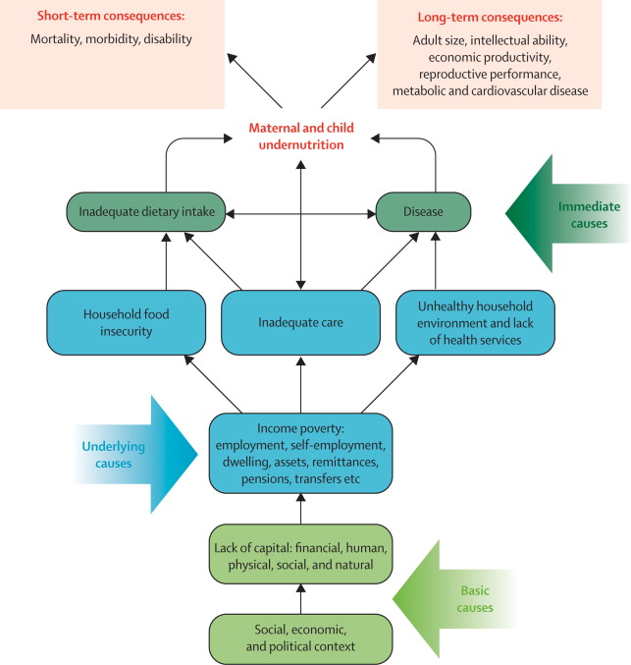
Consequences and Causes of Malnutrition
Causes of Malnutrition
Black et al 2008 Lancet Source: The Lancet 2008; 371:243-260

Slide 6
Immediate causes
Lack of food intake and disease create a vicious cycle in which disease and malnutrition exacerbate each other i.e. the Malnutrition-Infection Complex.
Infection Malnutrition
lack of food intake and disease must both be addressed to support recovery from malnutrition.
Causes of Malnutrition

Slide 7
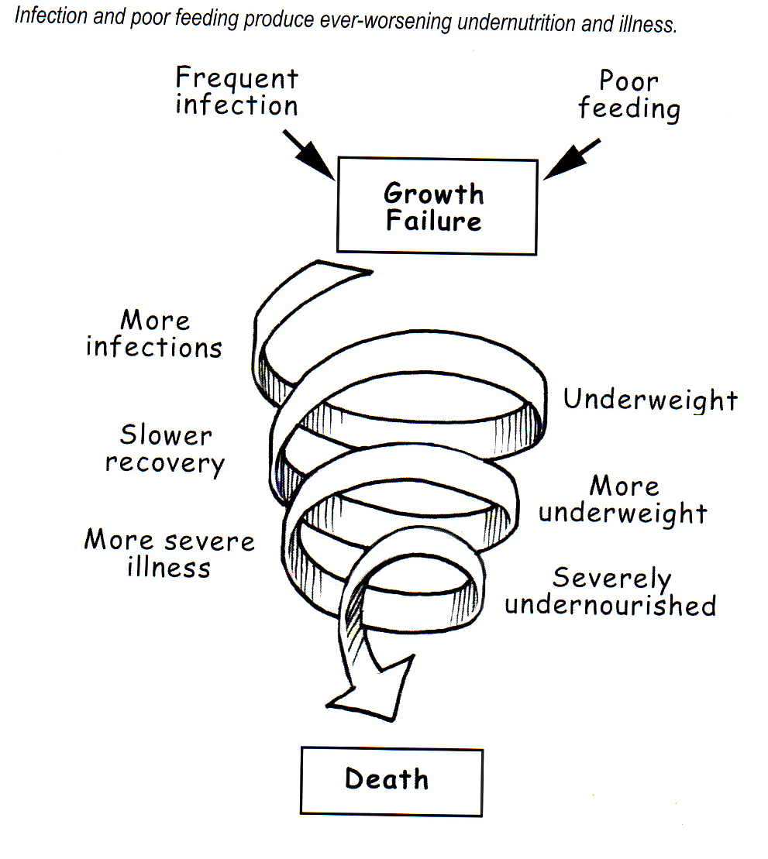
Spiral of infection and malnutrition
Causes of Malnutrition
Notes:
So why does malnutrition influence deaths from infection. Malnourished children have lower immunity so they tend to get ill more often, and when ill, the illness is more severe and longer lasting. This diagram shows that children can get progressively more and more undernourished and there is a spiral, or vicious cycle of infection and malnutrition that ends in death. When children are well-nourished, few die from infections.

Slide 8
Infections impair nutritional status by several routes
Reduced food intake
poor appetite
mother/carer may withhold food
Increased utilisation by the body
energy and nutrients
Losses during diarrhoea
protein, zinc
potassium, magnesium
Causes of Malnutrition
Notes:
Infections tend to reduce a child’s appetite and this reduces their food intake . Often mothers wrongly think it best to withhold food, especially if the child has diarrhoea or a bad cough. When the body is fighting infection, there is increased utilisation of energy and nutrients. And diarrhoea leads to loss of nutrients. So infection can worsen a child’s nutritional status in several ways.

Slide 9
Underlying Causes
Household Food Insecurity: Limited access or availability of food
Inadequate Care: Inadequate social and care environment in the household and local community
Un health household environment and lack of health services:
Income Poverty: employment, self employment, dwelling, assets, remittances, pensions, transfers
Causes of Malnutrition

Slide 10
Basic Causes
Regional and national level, where strategies and policies that affect the allocation of resources influence what happens at community level. Example of resources;
Human
Economic
Political and
Cultural
Geographical isolation and lack of access to markets due to poor infrastructure can have a huge negative impact on food security.
Causes of Malnutrition

Slide 11
Categories of Malnutrition
Four categories that can appear in isolation or combination:
Acute Malnutrition
Stunting
Underweight
Micronutrient Deficiency

Slide 12
Forms of Acute Malnutrition
Chronic malnutrition - determined by a patient's degree of stunting
Acute malnutrition - determined by the patient's degree of wasting. Acute malnutrition is categorised into:
Moderate Acute Malnutrition (MAM)
Severe Acute Malnutrition (SAM)
SAM is further divided into:
Marasmus
Kwashiorkor
Marasmic - kwashiorkor

Slide 13
ACUTE MALNUTRITION: NUTRITION INDICATORS
Severe acute malnutrition:
WFH <-3 z score or
Bilateral pitting oedema or
MUAC <11.5 cm for children and <16cm for adults
Moderate acute malnutrition:
WFH <-2 z-score or
MUAC 11.5 cm – 12.4cm

Slide 14
DIAGNOSIS OF ACUTE MALNUTRITION
Children who are malnourished are at high risk of mortality and morbidity.
They need fast appropriate care once identified by health facility staff

Slide 15
Diagnosis and Triage of Acute malnutrition
Step 1: Initial Screening and Referral at community level
Step 2: Medical assessment to identify individuals with Emergency signs and transfer to qualified health worker while using MUAC and/ presence of bilateral pitting oedema
Step 3: No emergency signs, conduct medical assessment to identify priority signs
Step 4: Nutritional screening at Health facility for non- urgent cases
Notes:
Priority signs :Tiny baby - Sick infant less than 2 months of age, Temperature – very high > 39.5⁰C, Trauma – major trauma, Pain – child in severe pain, Poisoning – mother reports poisoning, Pallor – severe palmar pallor, Restless / Irritable / Floppy, Respiratory distress, Referral – has an urgent referral letter, Malnutrition - Visible severe wasting , Edema of both feet, Burns – severe burns

Slide 16
Diagnosis and Triage of Acute malnutrition
Step 5: Conduct thorough medical assessment consisting of physical examination and medical history
Step 6: Conduct Appetite Test if the individual has severe acute malnutrition
Step 7: Identify underlying causes of acute malnutrition
Step 8: Based on the above medical, nutrition and causal assessment, determine the management of the individual
Notes:
Priority signs :Tiny baby - Sick infant less than 2 months of age, Temperature – very high > 39.5⁰C, Trauma – major trauma, Pain – child in severe pain, Poisoning – mother reports poisoning, Pallor – severe palmar pallor, Restless / Irritable / Floppy, Respiratory distress, Referral – has an urgent referral letter, Malnutrition - Visible severe wasting , Edema of both feet, Burns – severe burns

Slide 17
1. Marasmus 2. Kwashiorkor
Step 1: CLINICAL FEATURES OF ACUTE MALNUTRITION

Slide 18
Marasmus
Severe weight loss
Ribs prominent
Muscle wasting with emaciated limbs
Alert, irritable
Normal hair
Thin, flaccid skin, hanging in loose folds; “old man’s appearance)
May have good appetite
With correct treatment, good prognosis

Slide 19
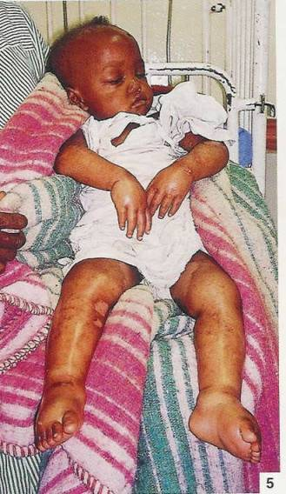
Kwashiorkor
Bilateral oedema and fluid accumulation
Brittle, thinning hair, can be pulled out easily leaving
Reduced fat muscle tissue which may be masked
Face may seem swollen (“moon face”)
Apathetic and irritable
Hair color change (yellow / reddish)
Loss of appetite
High risk of death

Slide 20
Classification for moderate malnutrition and at risk
Indicator | Moderate Acute Malnutrition | At risk of Acute Malnutrition
Children 6 to 59 months
WFH Z-Scores | ≥-3 z-score to < -2 z- score | ≥-2 z-score to <-1 z-score
MUAC | ≥11.5 cm to < 12.5 cm | ≥12.5 cm to< 13.5 cm
Bilateral Pitting Edema | Absent | Absent
Older Child (5 years to 9 years
BMI for Age | ≥-3 z-score to < -2 z- score | ≥-2 z-score to <-1 z-score
Bilateral pitting edema | Absent | Absent

Slide 21
Classification for moderate malnutrition and at risk
Indicator | Moderate Acute Malnutrition | At risk of Acute Malnutrition
Adolescent (10 years to 17 years)
BMI for Age | ≥-3 z-score to < -2 z- score | ≥-2 z-score to <-1 z-score
Bilateral pitting edema | Absent | Absent
Adults (18 years and older)
MUAC | N/A | N/A
MUAC | 18.5-21.4 | N/A
BMI | 16 to <17 | 17 to <18.5
Bilateral pitting edema | Absent | Absent

Slide 22
Classification for moderate malnutrition and at risk
Indicator | Moderate Acute Malnutrition | At risk of Acute Malnutrition
Pregnant and Lactating Women
BMI for Age | ≥-3 z-score to < -2 z- score | ≥-2 z-score to <-1 z-score
Bilateral pitting edema | Absent | Absent
Adults living with HIV/AIDS (PLWHA)
MUAC | N/A | N/A
MUAC | 18.5-21.4 | N/A
BMI | 16 to <17 | 17 to <18.5
Bilateral pitting edema | Absent | Absent

Slide 23
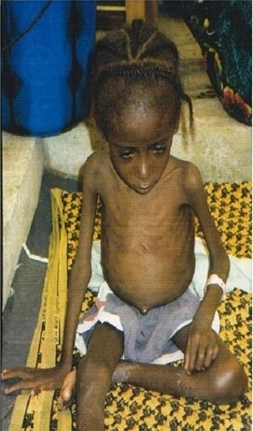
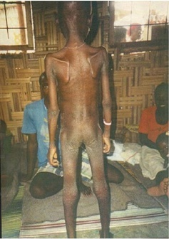
Exercise 1A:
What visible signs of severe acute malnutrition can you see?
FRONT
BACK

Slide 24
Exercise 1b :
What visible signs of severe acute malnutrition can you see?

Slide 25
Exercise 1C:
What visible signs of severe acute malnutrition can you see?

Slide 26
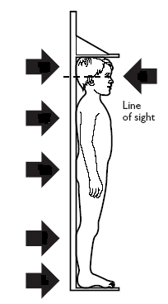
ANTHROPOMETRIC MEASUREMENTS
Mid-Upper Arm circumference
Height
Body Mass Index
Weight

Slide 27
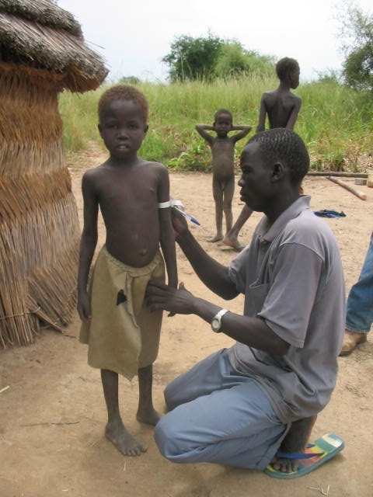
How to measure MUAC
MUAC is the circumference of the left upper arm, measured at the mid-point between the tip of the shoulder and the tip of the elbow
MUAC is used to assess wasting
Use a colour coded tape, or a measuring tape that measures in cm

Slide 28
After placing the tape at the correct position ( see pointer no. 10)
Make sure the tape has correct tension and is not too tight or tool loose
Read and record the measurement to the nearest 0.1 cm
Measuring MUAC

Slide 29
How to Measure Length/Height
Use a measuring board – standing for height and laid flat on a table or ground for length
Children <87cm or too weak to stand, measure length (lying down)
Children >87cm measure height (standing)
Need two people to take correct height/length measurements
One holding the child’s legs and feet, and the other the child child’s head

Slide 30
PERSON 1
Lay the board flat on a table
Position child lying on his back, support head and place against headboard
Hold head with two hands and tilt upwards so the eyes face up
Measuring length

Slide 31
PERSON 2
Press shins or knees gently and firmly
Straighten knees
Place foot piece firmly against feet so that soles are flat on the board and pointing up
Measure length to last completed 0.1cm
Measuring length

Slide 32
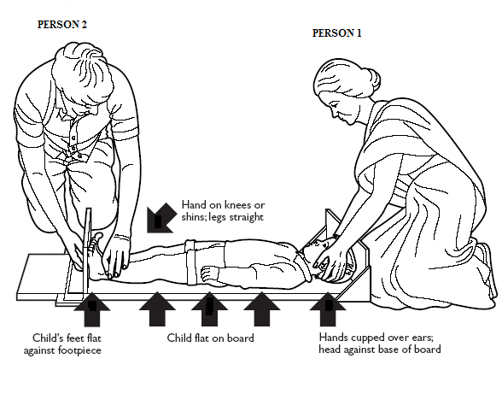
Measuring length

Slide 33
Height is taken when child is standing
Height board should be against the wall
Ensure child’s heels, back legs, buttocks, shoulders and head all touch the back of the board
Measuring Height

Slide 34
Heels should be FLAT on the floor of the board, and feet close together
Knees, back, neck should be straight
Childs arms should be straight down, by his/her side (make sure the child is not grasping the back of the board).
Child’s head should be straight and looking ahead.
Measuring Height

Slide 35
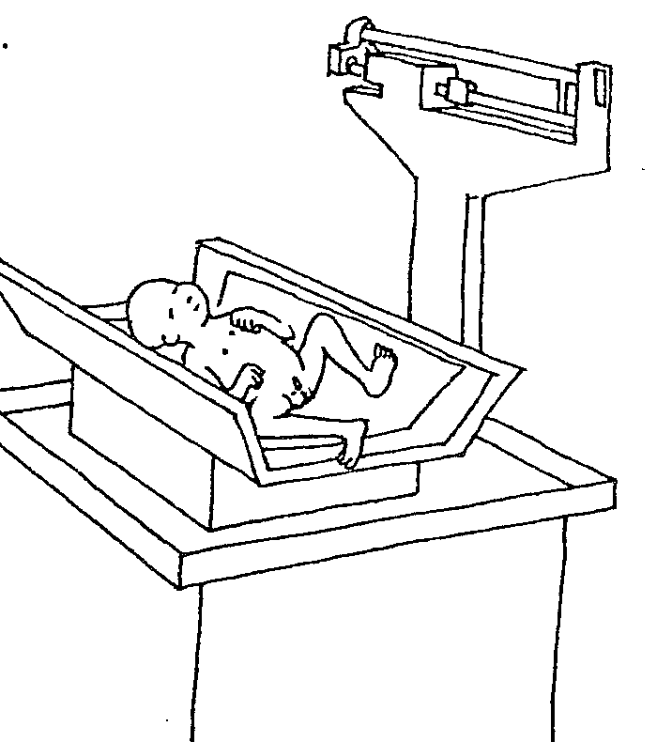
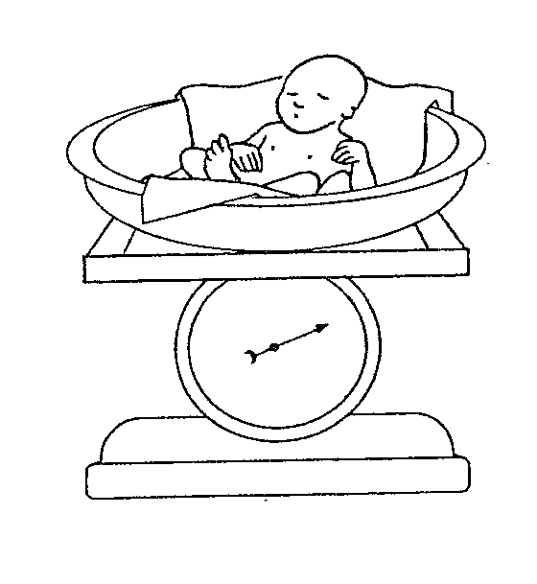
HOW TO MEASURE WEIGHT
Types of weighing scales
Measuring Weight

Slide 36
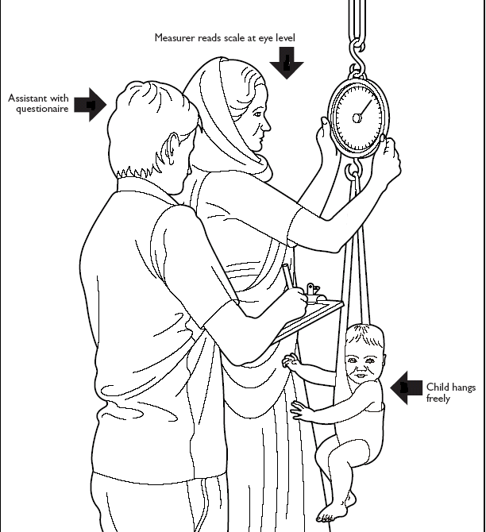
Before weighing the child, take all his/ her clothes off
Zero the weighing scale
Ensure that the weighing scale is at eye level
Place the child in the weighing pants
Measuring Weight

Slide 37
Make sure the child is not holding onto anything
Read the child’s weight. The arrow must be steady.
Record the weight in kg to the nearest 100g e.g. 6.6 kg
Do not hold the scale when reading the weight
Measuring Weight

Slide 38
How to check for Oedema
Grasp the feet so they rest on your hands with your thumbs on top of the feet
Press your thumbs gently for three seconds
If there is oedema, a pit (dent) remains on both feet when thumbs are lifted
Assessing Oedema

Slide 39
Dermatosis in Oedema
Common in children with oedema
Patches of skin abnormally light or dark
Shedding of skin, ulceration of skin and/or weeping lesions
Assessing Oedema

Slide 40
Step 3: CALCULATING ANTHROPOMETRIC INDICES
Weight-for-Height
Body Mass Index (BMI)

Slide 41
Weight for Height
In emergencies, weight for height (wasting) is the primary nutritional index of concern as it reflects recent changes in dietary intake and infection.
Wasted children can rapidly deteriorate but will also improve rapidly if treated appropriately.
There are two main methods for comparing a child’s measurements with the reference values.
Calculating either their Z score (standard deviation score) from expected values or the percentage of the median.

Slide 42
SD SCORE:
Standard deviation (SD) scores are a measure of the distance between the child’s value and the expected value of the reference population.
Ninety-five per cent of the reference population has anthropometric SD scores between -2 and +2, which is within the normal range.
If a child’s SD score falls outside the normal range, this signals a deviation from the norm in his/her nutritional status.
The SD score is a more accurate way of presenting prevalence data in population-level surveys.
Weight-for-Height

Slide 43
Calculating Z-scores:
Use weight-for-height reference table
Find the child’s length or height in the middle
Use left columns for boys, right for girls
Find SD Score at the top of the column
If weight is between an Z-Score, write “less than” (<)
Weight-for-Height

Slide 44
Exercise:
A boy measures 84.2 cm in length and weighs 9.9kg.
Calculate his weight for height Z-score

Slide 45
Solution: Calculating Z score:
The reference population data in handout 3e, shows that the reference median weight for boys of 84 cm is 11.7 kg and that the SD for the reference distribution for boys of 84 cm is 0.908.
SD Score= Measured weight – Median weight of reference population
Standard deviation of reference population
= 9.9 – 11.7
0.908
= -1.98SD Score
This boy is moderately malnourished according to his Z score
Need to practice direct use of reference tables
Weight-for-Height

Slide 46
Body Mass Index
The most useful measure of malnutrition in adults is body mass index (BMI)
BMI is an indicator of weight deficit in relation to height, which is equivalent to wasting.
BMI = Weight(kg)
Height (m²)
Body Mass Index

Slide 47
Example
A young, non-pregnant woman’s height is 1.60 m and her weight is 50 kg.
Body mass index= Measured weight (kg)
height(m²)
50 kg
1.6m²
BMI =19.5
This woman is not malnourished
Body Mass Index

Slide 48
TRIAGE OF ACUTE MALNUTRITION
Children who are malnourished need fast appropriate care once identified by health facility staff

Slide 49
Triage of acute malnutrition
Severe acute malnutrition
Severe with complications ( IMCI danger signs and Oedema ++ & +++ )
Severe without complications – ( no danger signs, no/ + oedema and has appetite)
Moderate acute malnutrition
At risk of malnutrition
Healthy

Slide 50
Management Triage
Conduct Individual Assessment
Classify Nutritional Status
Findings
Action
Health Worker
Severe Acute Malnutrition
Moderate Acute Malnutrition
At Risk of Acute Malnutrition
If severe with Complications
If severe with no complications
If moderately malnourished
If at risk of malnutrition
Refer to inpatient care for management of severe acute malnutrition
Refer to out patient care for management of severe acute malnutrition
Refere to a supplementary feeding programme for management of moderate acute malnutrition
Undertake the following:
1. Medical treatment
2. Nutrition Counseling
3. Immunization
4.Follow- up visits

Slide 51
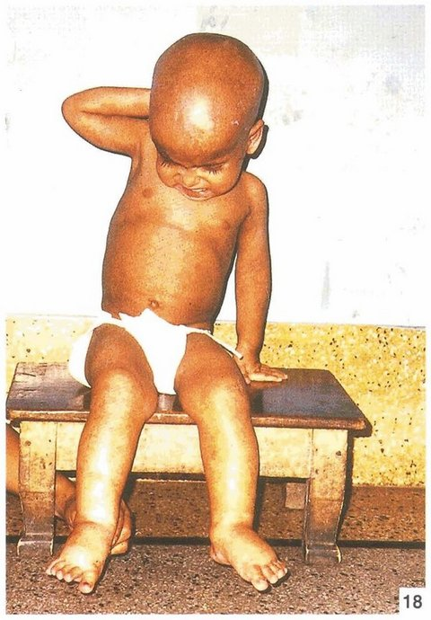
Exercise 1
This is a girl, age 20 months. She is 67cm in length and weighs 6.5kg
To which programme should she be admitted?

Slide 52
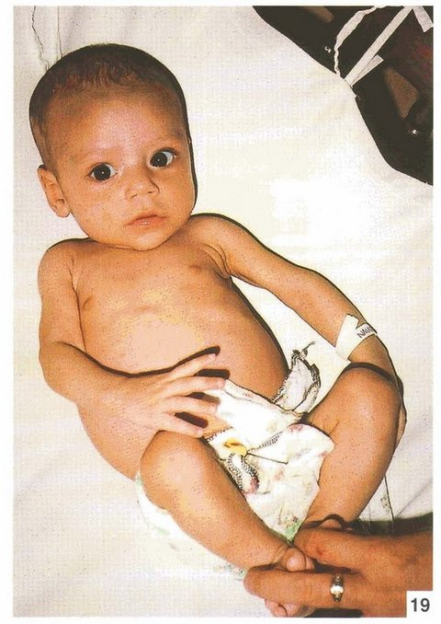
Exercise 2
This is a girl, age 6 months. She is 60cm in length and weighs 4.0kg
To which programme should she be admitted?

Slide 53
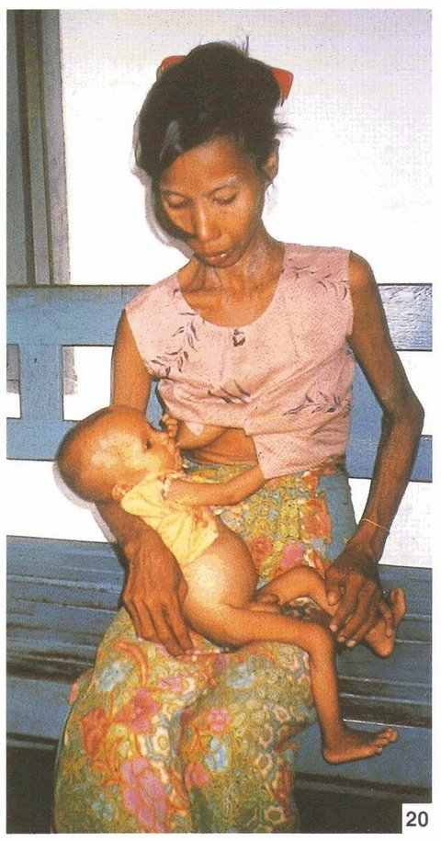
EXERCISE 3
This is a boy, age 18 months. He is 65cm in length and weighs 4.8g.
To which programme should she be admitted?

Slide 54
EXERCISE 4 GROUP DISCUSSION ON TRIAGE- ASSIGNMENT
How are children with severe acute malnutrition identified and prioritised in your hospital?
Where does it take place?
By who?
Should we be doing anything differently?

Slide 55
Answer sheet
Exercise 1 = <-1SD – she has Oedema +++ , her weight for Height appears normal but this is because of the fluid accumulation.
Oedema is a sign of severe malnutrition, therefore should be referred to in-patient care
Exercise 2 = <-2SD She is moderately malnourished. Admit to SFP and encourage mother to continue breastfeeding.
Exercise 3 = <-3SD. The boy is severely malnourished (visibly wasted). Conduct medical examination and appetite test. Determine if child will be admitted in OTP or in-patient care.

Slide 56
Questions

