Slide 1
Integrated management of acute malnutrition
Republic of Kenya
Nutrition Information, Education and Communication

Slide 2




ACKNOWLEDGMENT
MINISTRY OF PUBLIC HEALTH
MINISTRY OF MEDICAL SERVICES

Slide 3
Training Objective
Provide a framework for Community Health Workers (CHWs) to deliver nutrition-related information more effectively

Slide 4
Learning Objectives:
By the end of this session, participants should be:
  Conversant with considerations for successful nutrition education
  Able to identify steps in planning a nutrition education activity
  Knowledgeable on vital messages that should be relayed on specific nutrition subjects
  Able to conduct effective nutrition counseling

Slide 5
Importance of IEC
Information, education and communication about nutrition are the means to help people maximize their use of food and health resources
To change negative food-related behaviour, the people must be involved in understanding the causes of malnutrition in their situation
OVERVIEW

Slide 6
Ensuring Successful Nutrition Education
Consider the motivation of the people being reached.
Recognize that people have strong and established beliefs about their food and it takes time to influence change
Be based on a participatory assessment and analysis of the nutrition problem, and a carefully thought out plan of action.
Rely on observed behavioural practices
Target a specific group and communicate a clear message.
OVERVIEW

Slide 7
What factors should one consider when communicating a nutrition education message

Slide 8
Conducting a Nutrition Education Session
3. Identify the target individual(s) and/or group.
4. Build consensus about the problem with individual or community.
2. Prioritize the problem.
5. Select relevant nutrition and/or health topics/notes.
1. Identify the problems
6. Identify blocks (e.g. lack of resources, beliefs).
8. Evaluate your work (e.g. what was useful? new?).
7. Assess and select appropriate channels of communication (i.e. demonstration, songs, poem, and counseling).

Slide 9
Channels of Communication
Face to face
Mass media

Slide 10
Mass media communication
For effective results, use a mix of media options (e.g. radio and print) to clearly communicate a single message
  Examples:
  Print media
  Broadcast media
  Internet

Slide 11
Face-to-face / Interpersonal
Useful to reach individuals/ sub-groups with specific nutrition-related problems
    Examples:
    Group discussion
    Counselling
    Lectures

Slide 12
Nutrition Counseling

Slide 13
Importance
Nutrition counselling is essential at discharge for acutely malnourished individuals who are managed at home
Caregivers must know the proper feeding practices at home to avoid patient relapse or deterioration in nutrition status.
The MoH reccommends the GATHER Approach in conducting a nutrition counselling Session
NUTRITION COUNSELLING

Slide 14
GENERAL GUIDANCE
Who does the nutrition counselling | Nutritionists, nurses, clinicians, Community Health Workers, extension workers
When to do the nutrition counselling | During management, discharge, and follow-up of malnourished individuals
Who are the clients | caregiver of child (parents or guardian) community groups pregnant and lactating mothers adults who are malnourished or chronically ill
Materials and methods | Depending on the topic use national MoH guidelines such as the IMCI, guidelines on IYCF, Nutrition and HIV/AIDS Draw examples from local events and materials Use simple language that is easily understood Use pictures and posters to explain symptoms

Slide 15
Gather approach
Greet the patient and offer them a seat, introduce each other and know their well being
Ask their feeling about their nutritionals status, feelings, symptoms, nutritional problems and concerns.
Tell patient of different options that can be used to address the nutritional problems- communicate key messages
Help patient make informed choices and together develop action plan / approaches to address the problem
Explain fully the choices and actions and possible barriers
Reassure and give the Return date of the next visit
NUTRITION COUNSELLING

Slide 16
Nutrition education messages

Slide 17
High Impact Nutrition Intervention
Eleven evidence based interventions:
H1 Infant and Young Child Nutrition
Promotion of Exclusive Breastfeeding for the first six months of life
Promotion of optimal complementary feeding for infants after the age of six months
H2 Improved Hygiene Practices
3. Promotion of improved hygiene practices including hand washing

Slide 18
High Impact Nutrition Intervention
H3: Micronutrient Supplementation
4.Vitamin A Supplementation (2 doses per year for children 6-59 months)
5.Iron-folic acid supplementation for pregnant mothers
6. Zinc supplementation for diarrhea management
7. Multiple-micronutrients for children under five years
8. Salt Iodization
9. Iron fortification of staple foods

Slide 19
High Impact Nutrition Intervention
H4: De-worming
10. De- worming for children (2 doses per year for children 12-59 months)
H5: Integrated Management of Acute Malnutrition
. 11 Prevention and treatment of:
Severe Acute Malnutrition
Moderate under-nutrition

Slide 20
H1 Infant and Young Child Nutrition

Slide 21
1. breast feeding for the first 6 months of life
Place infant skin-to-skin with mother immediately after birth
Initiate breastfeeding within the first hour of birth
Benefits of Early Initiation

Slide 22
breast feeding for the first 6 months of life
Encourage and promote exclusive breastfeeding for infants from birth up to six months (no food or drink, not even water should be given to the baby during this period)
Breastfeed frequently, day and night
Encourage breastfeeding on demand

Slide 23
breast feeding for the first 6 months of life
Let infant finish one breast and come off by him/herself before switching to the other breast.
Good positioning and attachment
Show mothers how to breastfeed and to maintain lactation even if they should be separated from their infants

Slide 24
Exclusive breast feeding for the first 6 months of life
Continue breastfeeding for 2 years of age or longer
Continue breastfeeding when infant or mother is ill
Avoid feeding bottles. Do not give any feeds using bottles or teats

Slide 25
breast feeding for the first 6 months of life
Foster the establishment of breastfeeding support groups and other support groups and refer mothers to them on discharge from hospital or clinic

Slide 26
2. Optimal Complementary Feeding
  When to start complementary feeding
  What food to give and when
  How to prepare complementary foods hygienically
  Food variation to ensure nutrition adequacy

Slide 27
H2 improved hygiene practices

Slide 28
3. Promotion of improved hygiene practices including hand washing
General Health
Food Handling and Storage
Water
Disposal of Waste
Personal Domestic and Community Hygiene

Slide 29
H3 micronutrient supplementation

Slide 30
4. Vitamin A supplementation
Children
In Breast milk
Boost immunity
Vitamin A capsule 6-59 months need every 6 months
Food Sources: Fruits and Green leafy vegetable

Slide 31
Vitamin A Supplementation
Mothers
Receive 200,000 IU within 4 weeks of delivery
Record in immunization register and Mother and Child booklet

Slide 32
5. Iron Folate Supplementation
Children
One dose 6mg/kg for 14 days unless receiving RUTF
Avoid in children with sickle cell anemia

Slide 33
Iron Folate Supplementation
Mothers
All pregnant women from conception to delivery
Use of Antimalaria bednets
Three month anemia treatment with iron
Consumption of vitamin C rich foods

Slide 34
6. Zinc Supplementation
For all children with diarrhea
Combine with ORS for diarrheal treatment
Increase frequency of breastfeeding during diarrhea

Slide 35
7. Multiple MIcronutrient Powder
For children 6-23 months, 10 sachets a month
Add to child’s food. If Complementary feeding, add a sachet every 3 days
Immunity
Child Appetite
Not to be mixed with liquid or hot food

Slide 36
8. Salt Iodisation

Slide 37
9. Iron fortification of staple foods

Slide 38
H4 De- worming

Slide 39
10. Deworming for children
All childern 12-59 months
Untreated intestinal worms cause anemia and fatigue in children
De-worming medication is free

Slide 40
H5 integrated management of acute malnutrition

Slide 41
11. Prevention and Treatment
Severe Acute Malnutrition
Moderate Acute Malnutrition

Slide 42
Growth monitoring
  Monitoring weight beginning from birth
  Interpretation of information in a child’s growth chart
  Causes of inadequate growth and feasible options for action
  How to monitor growth
NUTRITION TOPICS

Slide 43
Growth promotion
  Adequate pre-conception and prenatal nutrition for mothers
  Exclusive breastfeeding for the first six months
  Appropriate complementary feeding with continued breastfeeding for 24 months
  Adequate nutritional care during illness malnutrition
  Adequate micronutrient intake
NUTRITION TOPICS

Slide 44
Moderate Acute Malnutrition
Children receive normal food in addition to supplementary food ration
Patience when feeding
Small frequent meals
NUTRITION TOPICS

Slide 45
Handout 8a
Role play

Slide 46
MONITORING AND EVALUATION
Nutrition education sessions

Slide 47
Why Monitor?
To determine the progress of a nutrition education programme towards achieving the set objectives.
Qualitative data can be collected continually to determine its appropriateness, effectiveness and the coverage of nutrition education programs.
At the onset of the program the implementers should develop a monitoring and evaluation plan.
The plan should be well understood by information collectors and be specific to the program.
MONITORING

Slide 48
Key Indicators
  Number of trainings conducted
  Number of program supervisors/ managers trained
  Number of community groups/individuals trained
  Number of peer educators trained
  Number of active peer educators
  Number of “trainers of trainers” trained
  Number of BCC materials developed
MONITORING

Slide 49
Evaluation
The plan for monitoring and evaluation should include; when
to do the evaluation, methodology, resources and type of indicators to be measured.
All information obtained is shared with all stakeholders to improve practices, scale-up interventions, revise guidelines and inform policy.
Often an evaluation will address two main
Evaluation will address two main questions:
  Are the results those that were intended?
  Are they of value or has there been a positive change?
EVALUATION

Slide 50
Evaluation Indicators
  Behaviour change
  Efficient use of resources and management of program
  Cost effectiveness of the program
  Coverage of the program
EVALUATION

Slide 51
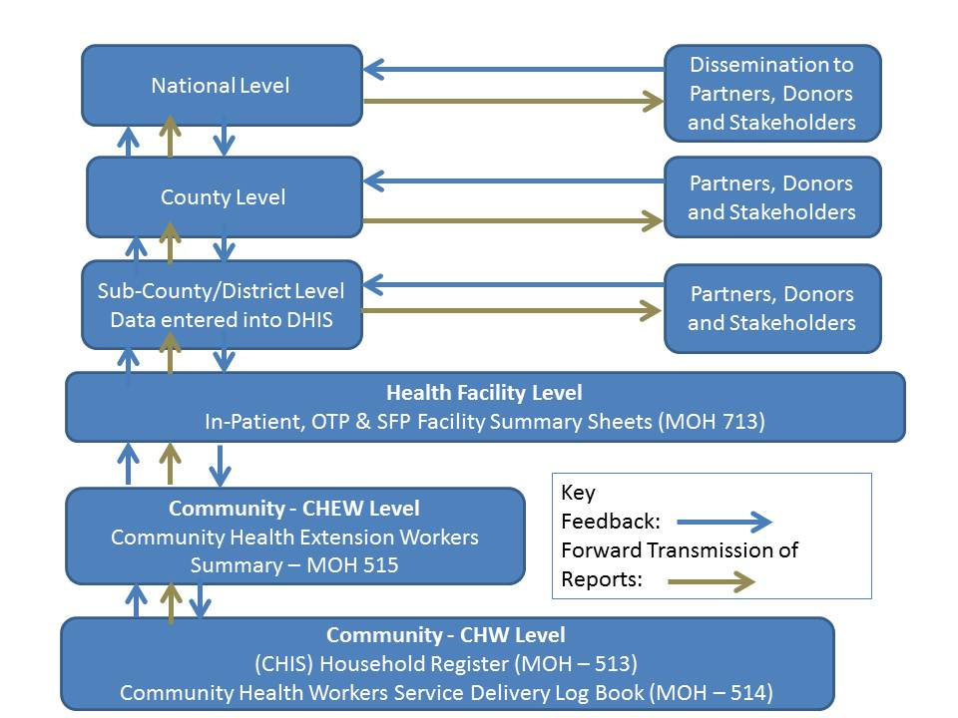
Kenya National Information Flow and Transmission

Slide 52
questions

