Slide 1
Overview of Malnutrition

Slide 2
Broad Training Objective
To assist health workers in the assessment and appropriate management of services and/or counseling for the treatment of acute malnutrition both Moderate Acute Malnutrition (MAM) and Severe Acute Malnutrition (SAM) affecting the vulnerable population.

Slide 3
Specific Objectives
Describe the overview of malnutrition situation globally
Highlight the causes of malnutrition
Explain why its necessary to manage malnutrition
Establish your role as a health worker in management of malnutrition

Slide 4
Overview
Malnutrition defines a state when the body does not have enough of the required nutrients (under-nutrition) or has excess of required nutrients (over-nutrition).
Globally over 2 million children are severely malnourished at any given time
Severely Malnourished children have 5 – 20 times higher chances of death than well nourished children
1million children in the world die due to severe malnutrition
Out of the 10 million children who die yearly, 5 million succumb to malnutrition related causes

Slide 5
Overview cont…
Widespread hunger and malnutrition continue to exist amid natural calamities, wars, drought and disease
The cost is measured in terms of human dignity, the quality of life and economic terms
For over 20 years we have had clear evidence for the effectiveness of low cost approaches to management of severe malnutrition

Slide 6
Overview cont….
Malnutrition is a condition that results from:
Eating a diet in which certain nutrients are lacking (under-nutrition);
Eating a diet that does not provide adequate calories and protein for growth and maintenance (under-nutrition);
the inability of the body to fully utilize food eaten due to illness (under-nutrition); consuming too many calories (over-nutrition);
eating a diet with nutrients in the wrong proportions.

Slide 7
Global situation

Slide 8
Global Situation
Nearly half of all deaths in children under 5 are attributable to undernutrition. This translates into the unnecessary loss of about 3 million young lives a year.
Undernutrition puts children at greater risk of dying from common infections, increases the frequency and severity of such infections, and contributes to delayed recovery.
Poor nutrition in the first 1,000 days of a child’s life can also lead to stunted growth, which is irreversible and associated with impaired cognitive ability and reduced school and work performance.

Slide 9
copyright Oxford Cartographers 2003
Where are child
deaths occurring?
Each dot represents
5000 deaths
copyright Oxford Cartographers 2003
Most child deaths (40%) occur in s-S Africa
6 countries account for 50% of child deaths in s-S Africa
  Nigeria, Democratic Republic of Congo, Ethiopia, Tanzania, Uganda and Kenya
Lancet 2003, 361: 2228
Notes:
Each dot on the map….Most child deaths occur in sub S Africa (about 40% of the total).because most of the African countries have very high child mortality rates. South Asia accounts for 34%. Remarkably, just 6 countries account for…..These are India…. India has more child deaths than any other country partly because of its huge population size. Altogether, 99% of under-5 deaths occur in poor countries.

Slide 10
National and County situation
Malnutrition type | Situation (%) SMART survey June 2019 | Kenya (KDHS 2014)
Wasted | 25.6 | 4
Underweight | 34.0 | 11
Stunted | 23.3 | 25

Slide 11
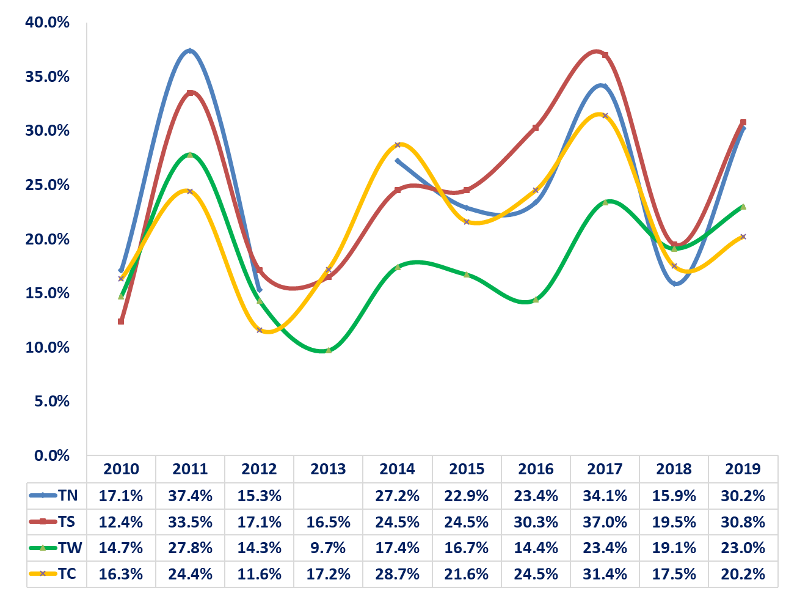
GAM Trends from 2010- 2019

Slide 12
Possible causes of malnutrition
The deterioration in the nutrition situation mainly attributed to;
  The then declining food security situation
  High cases of child morbidity
  Poor hygiene and sanitation
  Poor MIYCN practices
  Low micronutrient supplementation and deworming
  Insecurity/loss of assets

Slide 13
Forms of Malnutrition
Acute malnutrition (SAM and MAM),
Stunting,
Underweight
Micronutrient deficiencies.
The four forms can appear isolated or in combination but most often they overlap in one child or in a population.

Slide 14
Forms of Acute Malnutrition
There are two forms of acute malnutrition:
  Severe Acute Malnutrition (SAM) is defined by severe wasting , and/or the presence of bilateral pitting edema.
  Moderate Acute Malnutrition (MAM) is defined by moderate wasting.

Slide 15
Terms are used to describe the clinical manifestations of SAM
Marasmus, characterized by severe visible wasting. There is loss of fat and muscle, which the body breaks down for energy.
Kwashiorkor, characterized by bilateral pitting edema (affecting both sides of the body) in the feet and lower legs which as it progresses becomes more generalized to the arms, hands and face.
Marasmic kwashiorkor, characterized by a combination of severe visible wasting and bilateral pitting edema

Slide 16
What must we do?
Intervene early, before children become severely malnourished
    Improve access to care in the community
    Increase coverage of services, and equity
Improve nutritional status
    Feeding practices
    Food security
Reduce exposure to infections

